Slide 1

Unit-04 Prototyping and Styling
UI/UX Designing (UI/UX)
DU # 2301CS622
Prof. Mayur Padia
Department of Computer Science & Engineering
mayur.padia@darshan.ac.in
99255 15118

Slide 2

Looping
Outline
Information Architecture
Wireframing
Prototyping
Fidelity of a Prototype - High / Medium / Low
Paper Prototyping
Digital Prototype
Grid and Layout Systems
Interaction Design
Navigation
Sequential Navigation
Breadcrumb Navigation
Associative Navigation
Click versus Clock
Organization Schemes
Information Design
Sketching Screens
Flat vs. Deep Hierarchies
Creating Error Messages

Slide 3
Information Architecture
Section – 1

Slide 4
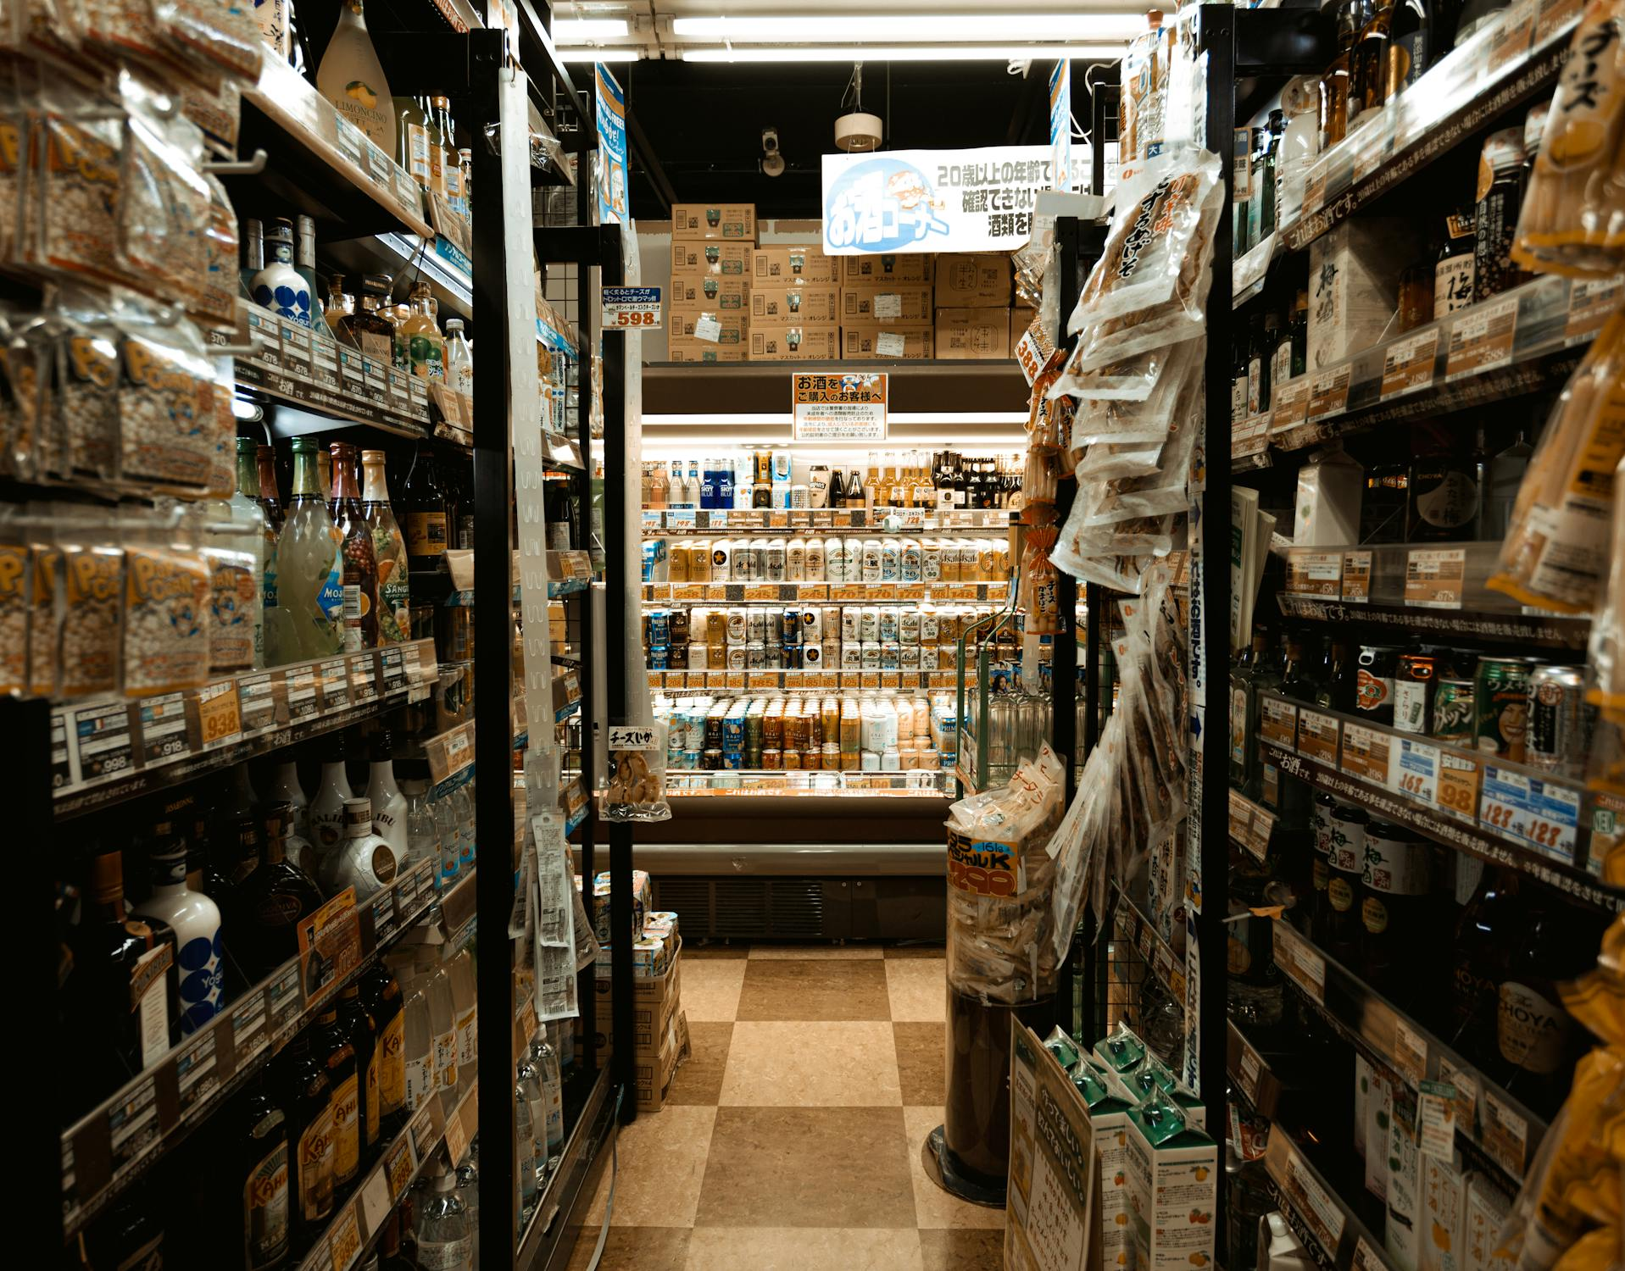
Information Architecture (IA)
Information architecture (IA) is the discipline of making information findable and understandable.
It includes searching, browsing, categorizing and presenting relevant information.
It helps people understand their surroundings and find what they’re looking for online and in the real world.
IA is used in physical spaces like museums or department stores, as well as in websites and applications.
E.g., your favorite packet of chips will always be in the snack aisle of your supermarket.

Slide 5


Information Architecture (IA) (contd.)
Information architecture operates from two perspectives:
People perceive information, products and services as places made of language.
These places can be arranged for optimal findability and understandability.
Good IA is informed by content, context and users.
Content
What kind of information is available?
What relevance does it have to the user?
Content consists of the document or data types, content objects, and existing structures.
Context
Where is the user seeking out the content?
When, why and how is the user engaging with the content?
Context relates to business goals, funding, culture, technology, politics, resources and constraints.

Slide 6

Information Architecture (IA) (contd.)
User
Who is consuming the content?
What value does it provide?
What preexisting expectations do they have?
Users comprise the audience, tasks, needs, experiences and how they seek information.

Slide 7
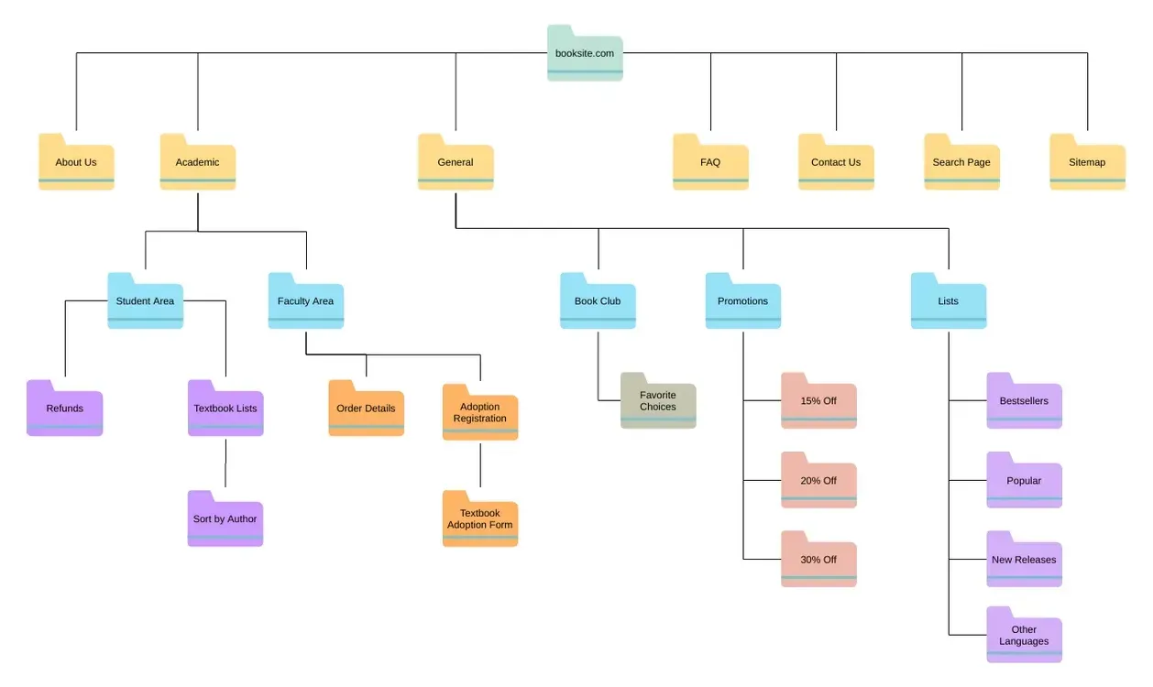
Information Architecture (IA) (contd.)
Information architecture starts with understanding people - the reasons to use a product or service.
A methodical and general approach to structuring information is needed to make it findable and understandable irrespective of the context, or medium employed by the user.
After understanding how a user behaves and seeks information, you can design a successful sitemap, website navigation, user flows and so on.

Slide 8
Information Architecture (IA) (contd.)
Designers need to understand the following when designing websites and applications:
The information needs of users
The site or app’s content
The business goals of the website, app, or organization
Here the deliverables includes:
site maps
wireframes
hierarchies
navigation
metadata

Slide 9
Activity
Prepare a sitemap for the problem statement SIH1609 of Smart India Hackathon.

Slide 10
Wireframing
Section - 2

Slide 11
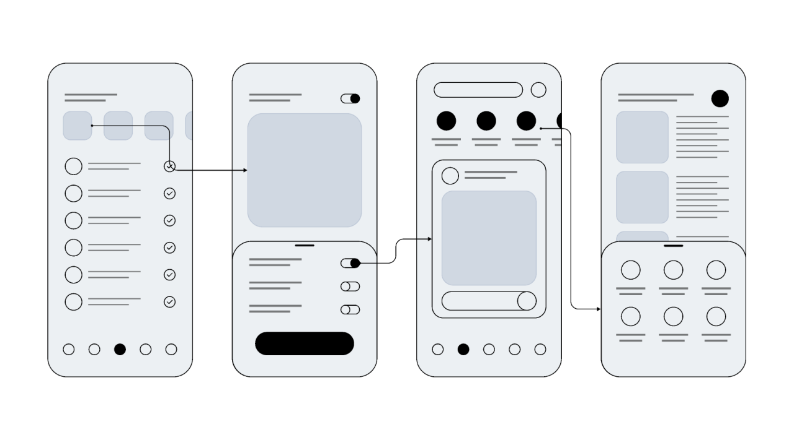
Wireframing
Wireframe is a basic, low-fidelity blueprint or layout of a digital product's user interface.
It focuses on the structure and functionality of the design rather than the visual details like colors, typography, or imagery.
Wireframes help designers and stakeholders understand the placement of elements
It helps to understand the navigation flow, and how users will interact with the interface.
Uses of Wireframes:
Visualizing and organizing content.
Testing navigation flows and user interactions.
Communicating ideas to stakeholders, developers, and team members.

Slide 12
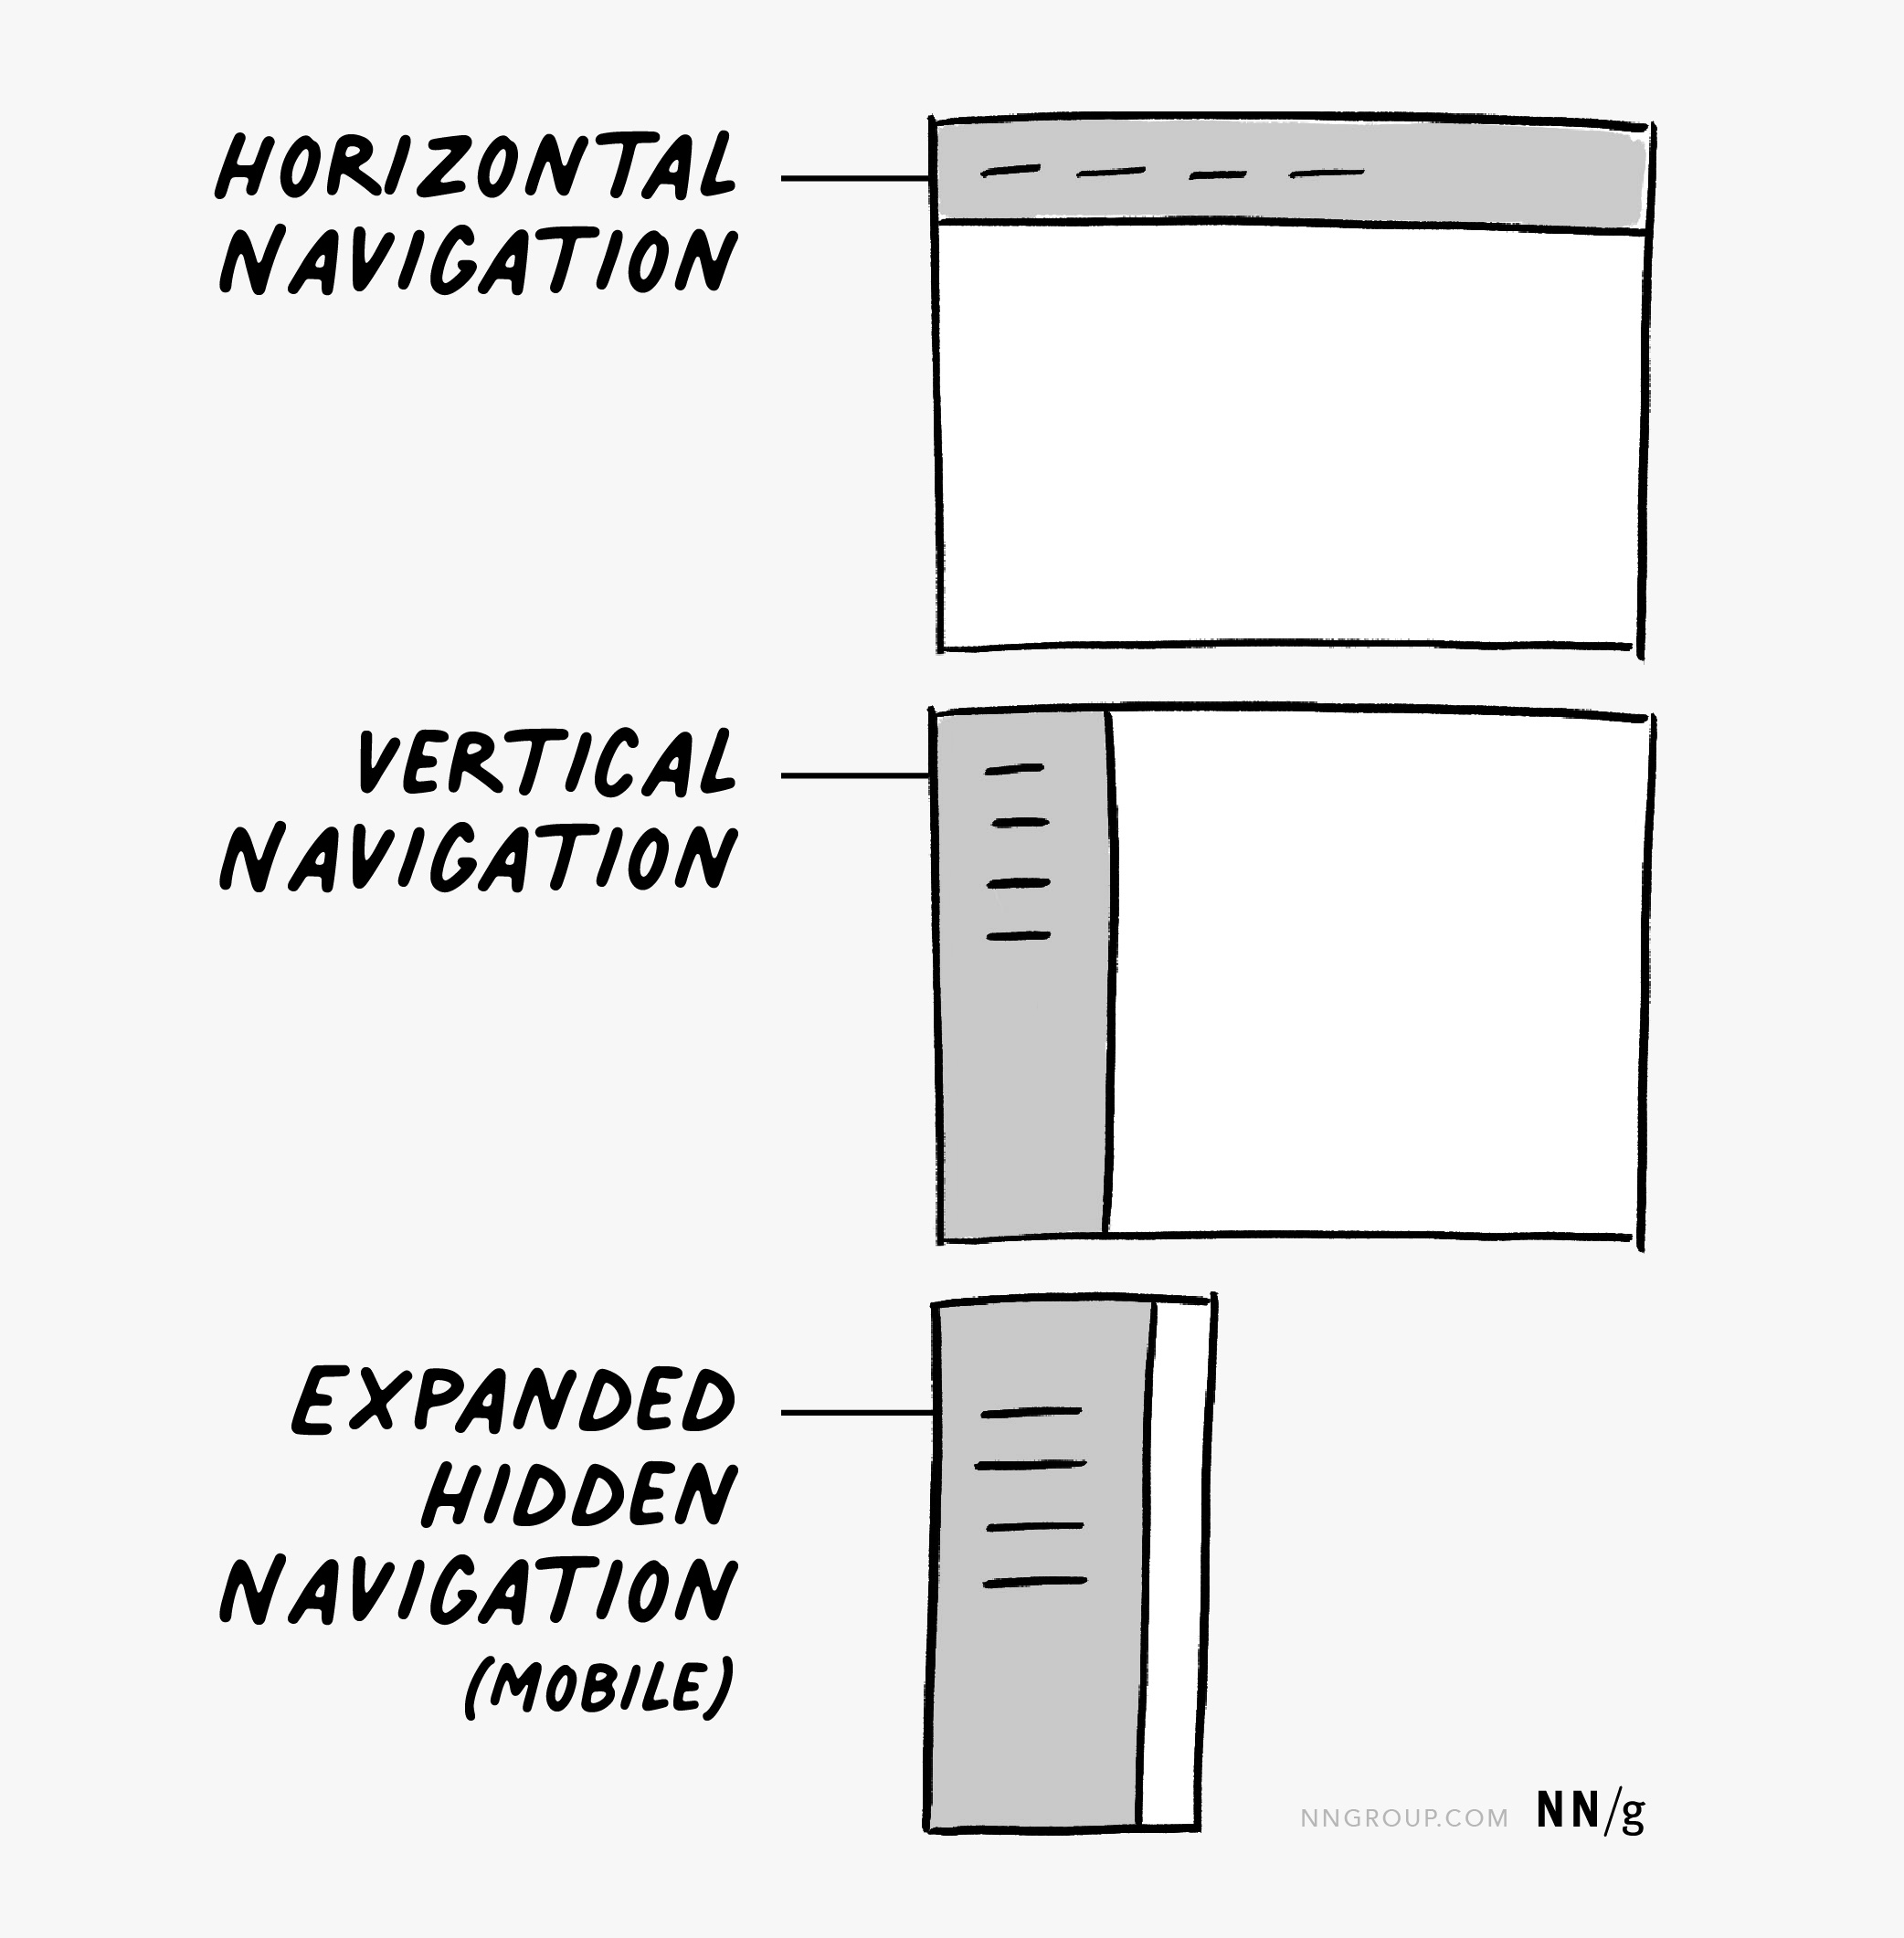
Wireframing Sketching Guide
Identify your browser-window or device aspect ratio.
For a higher-fidelity wireframe, starting dimensions are:
Web wireframes:
Sizes - 1024x768 pixels and 1920x1080 pixels.
Mobile wireframes:
e.g., tablet, various-size phones
Draw the navigation and search.
Navigation and search add background to a wireframe.
Indicate a navigation bar (whether horizontal or vertical) by drawing a rectangle in the corresponding position on the page.
If you’re using hidden navigation, show it expanded or not.

Slide 13
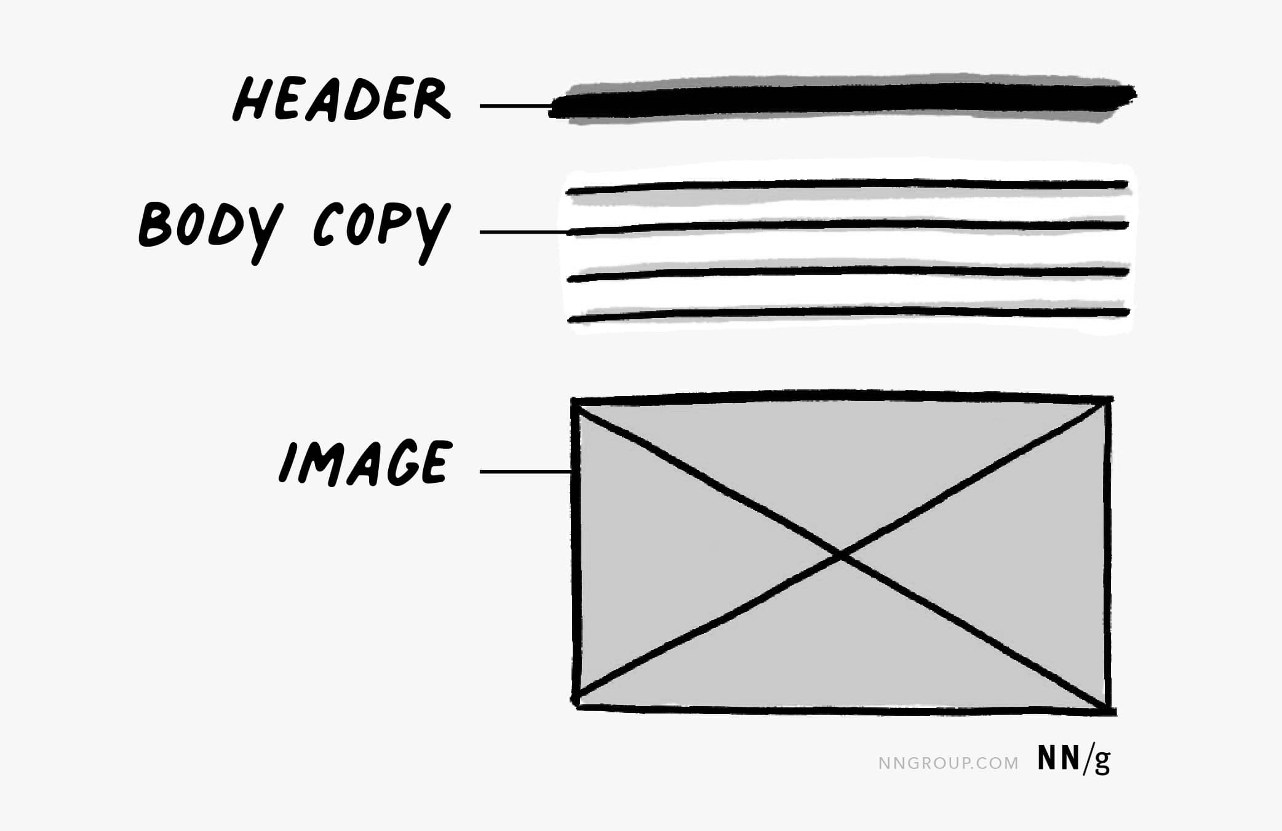
Wireframing Sketching Guide (contd.)
Identify and draw the largest elements in your design. Common wireframing conventions:
Headers are illustrated using thicker lines.
Body text is sketched using thinner lines.
An image is represented as a rectangle with an x through it.

Slide 14
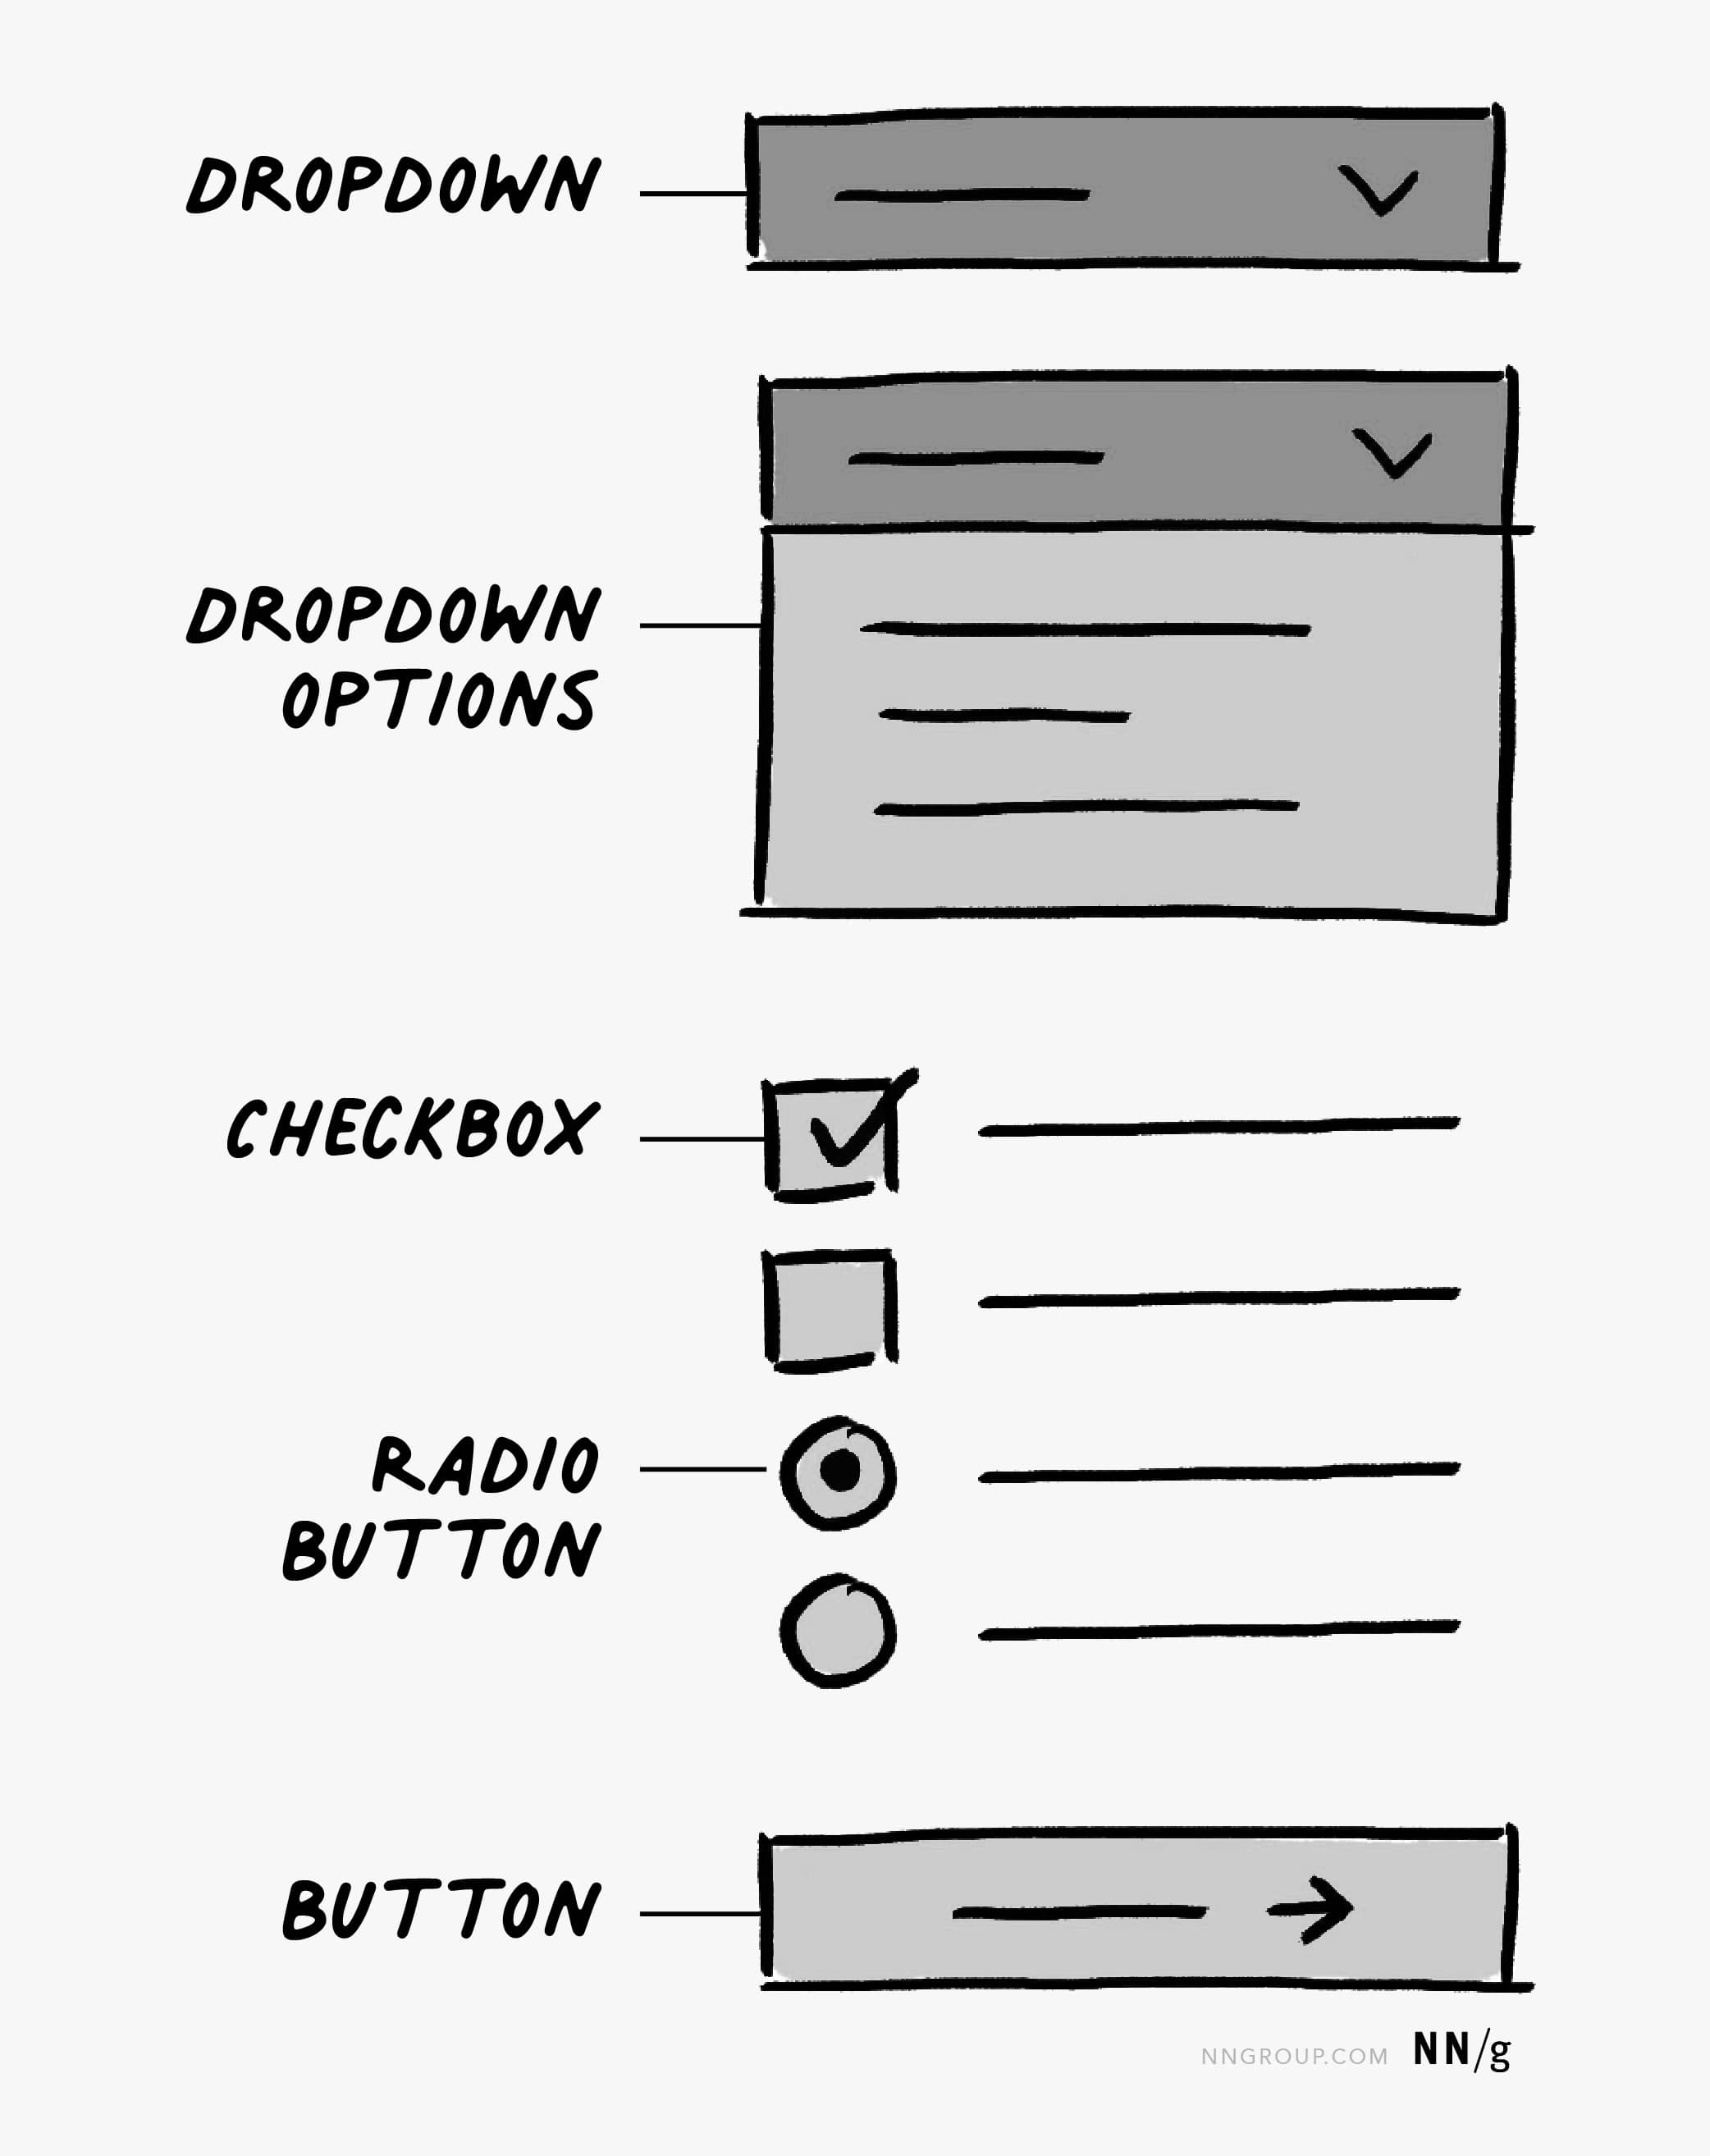
Wireframing Sketching Guide (contd.)
Fill other details like;
Add components like buttons, dropdowns, checkboxes, or ratio buttons
Also include text fields or any remaining single lines of body copy.
Add progress bars and dialogs.
Add calls to action or show selection if necessary.

Slide 15
Wireframing Sketching Guide (contd.)
Dropdowns are made of a rectangle and a caret.
Checkbox and radio buttons have a square or circle, respectively
A line to represent text.
To show selection, checkboxes should have a check and radio buttons will be filled in.
Buttons can be represented as:
Basic rectangle with a line or an arrow to represent
For calls to action, also include a text label to provide key details to others looking at your wireframes.

Slide 16
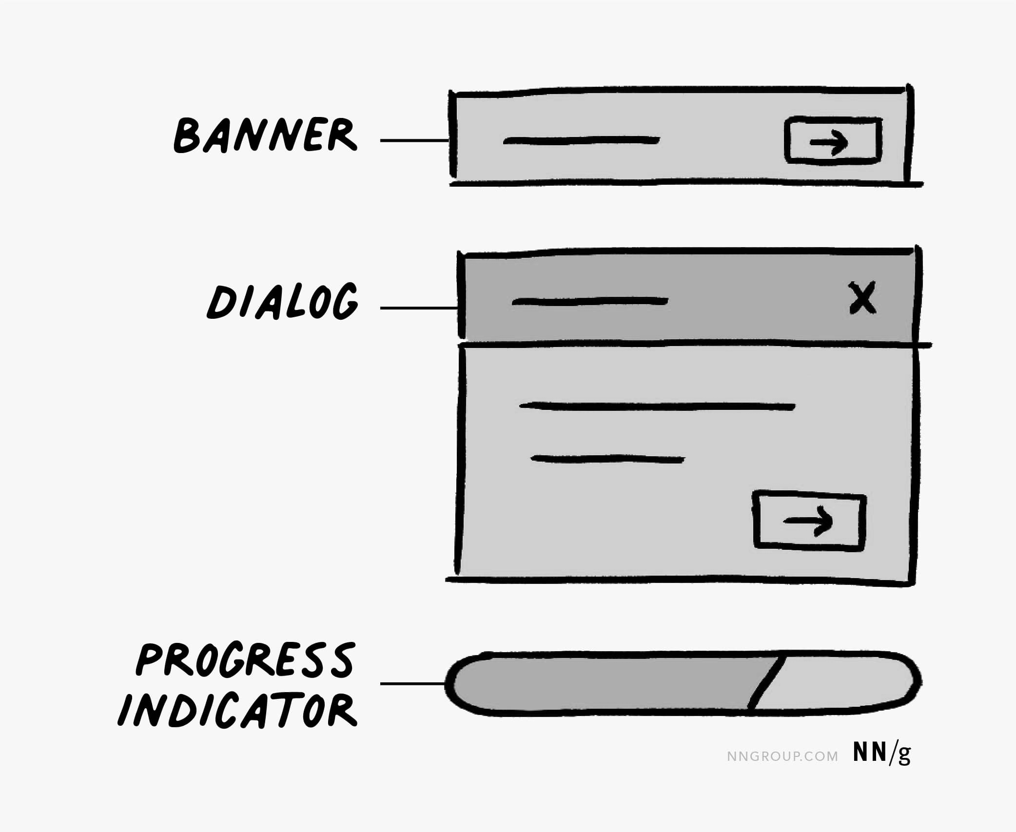
Wireframing Sketching Guide (contd.)
Banners have a line or two of text, with an optionally related button or Cancel icon.
Dialogs contain a header, 1–2 lines of text, 1–2 buttons, and a Cancel icon.
Progress indicators are rounded rectangles that are partially filled to illustrate the remaining wait time.
Icons can be represented as images (with an X) or as coarse line art.

Slide 17
Activity
Prepare a wireframe for Dashboard elements, Achievement, Job Portal screen of the problem statement SIH1609.

Slide 18
Prototyping
Section - 3

Slide 19
Prototyping
A prototype is an early model of a product that demonstrates its functionality, without actually building the entire product.
A prototype shows stakeholders and your potential users what your design idea can do.
Different types of prototypes are:
Low-fidelity prototypes
High-fidelity prototypes
Prototypes are a fantastic way to:
Preview interactions and user flows
Share and iterate on ideas
Get feedback from collaborators
Test interactions with users
Present your designs to stakeholders

Slide 20
Prototype Connection
Hotspot: A hotspot is where the interaction takes place.
A hotspot can be the frame itself, or an object within the frame.
You can create a hotspot on anything, like a button, icon, or heading.
Connection: A connection is the arrow that connects the hotspot to the destination.
Define the interaction trigger, actions, and adjust animation settings from the connection.
Destination: The destination is where a connection ends.
The destination must be a top-level frame.
Only connections using the Scroll to action can be set to a destination within the same top-level frame.

Slide 21
#Define
“The fidelity of a prototype refers to how it conveys the
look-and-feel of the final product.”

Slide 22
Fidelity
Fidelity can vary in the areas of:
Visual design
Content
Interactivity
Product teams choose a prototype’s fidelity based on the goals of:
Prototyping
Completeness of design
Available resources

Slide 23
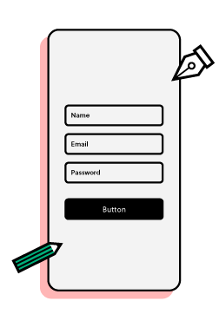
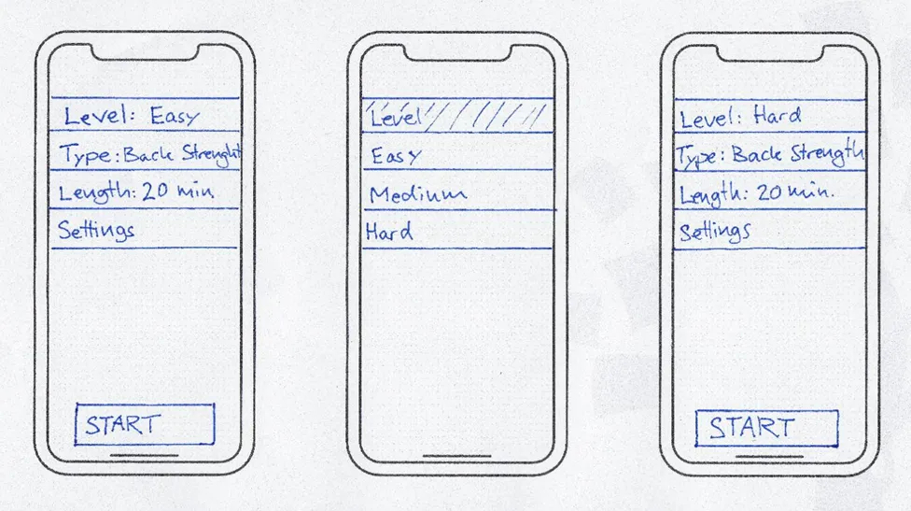
Low-Fidelity (lo-fi)
Low-fidelity (lo-fi) prototyping is a quick and easy way to translate high-level design concepts into solid and testable artefacts/remembrance.
It check and test functionality rather than the visual appearance of the product.
Paper prototyping and clickable wireframes are popular lo-fi prototyping types.

Slide 24
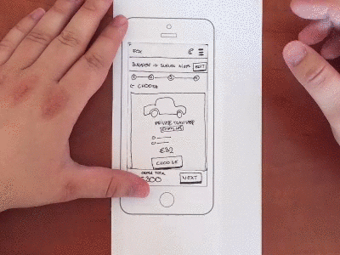
Characteristics of Low-Fidelity Prototypes
Visual design
Only some of the visual attributes of the final product are presented.
Such as shapes of elements, basic visual hierarchy, etc.
Content
Only key elements of the content are included.
Interactivity
The prototype can be simulated by a real human.

Slide 25
Benefits of Low-Fidelity Prototypes
Inexpensive
Rapid Iteration
Low commitment
Encourage honest feedback
Collaborative activity

Slide 26
High-Fidelity (hi-fi)
High-fidelity prototypes are computer-based, and usually allow realistic (mouse-keyboard) user interactions.
High-fidelity prototypes take you as close as possible to a true representation of the user interface.
Designers can add interactions, transitions, and animations to create an captivating user experience.
It makes high-fidelity prototypes perfect for usability studies and presenting to stakeholders.
Different types of high-fidelity prototypes are:
Mock-ups
Prototype using code

Slide 27
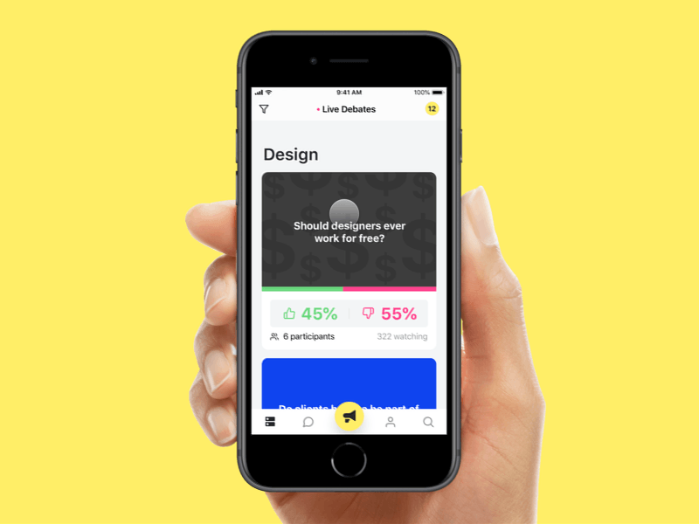
Characteristics of High-Fidelity Prototypes
Visual design
Realistic and detailed design.
All interface elements, spacing, and graphics look just like a real app or website.
Content
Designers use real or similar-to-real content.
The prototype includes most or all of the content that will appear in the final design.
Interactivity
Prototypes are highly realistic in their interactions.

Slide 28
Benefits of High-Fidelity Prototypes
Prototypes with high-fidelity interactivity have realistic (faster) system response during the test.
With high-fidelity interactivity and/or visuals, you can test workflow, specific UI components.
High-fidelity prototypes often look like “live” software to users.
Interactive-prototype testing reduces human error.

Slide 29
Comparison between Lo-fi and Hi-fi
Lo-fi Prototypes | Hi-fi Prototypes
Testing initial ideas | Testing and validating individual design decisions
Quickly outlining the flow | Getting insights into, what the end product will look like
Checking usefulness & usability of proposed functionality | Usability testing with real users
Rapidly sizing the project scale | Pitching ideas into a non-technical audience or stakeholders
Types: Paper Prototypes, Clickable Wireframes | Types: Mock-up Prototypes, Coded Prototypes

Slide 30
Grid and Layout Systems
Section – 4

Slide 31
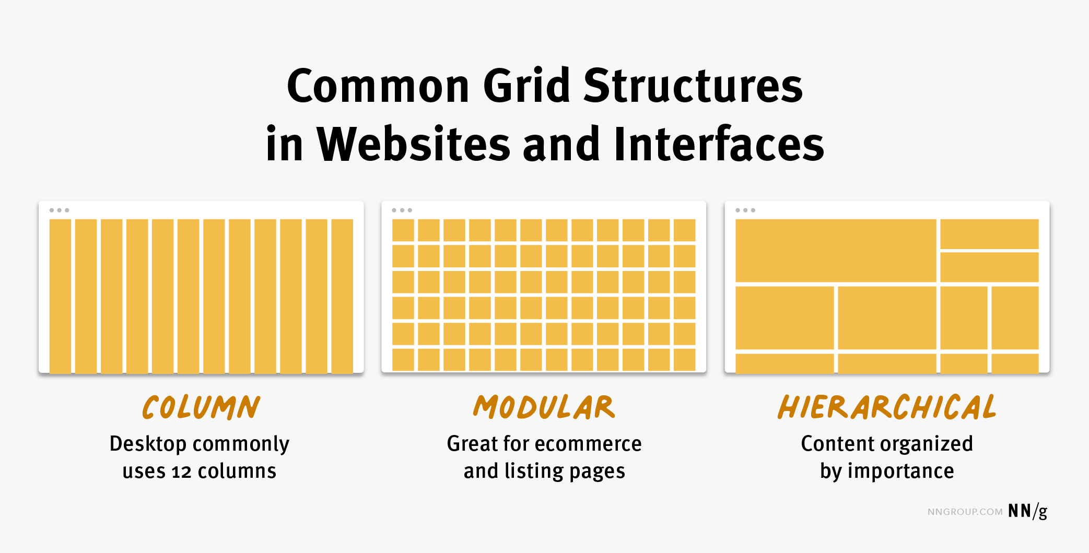
Grids
Grid is a visual made up of columns, gutters, and margins that provide a structure for the layout of elements on a page.
There are three common grid types used in websites and interfaces:
column grid
modular grid
hierarchical grid

Slide 32
Grid Elements
The grid is made up of three elements: columns, gutters, and margins.
Columns take up most of the space in a grid.
Elements and content are placed in columns.
To adapt to any screen size, column widths are generally defined with percentages rather than fixed values and the number of columns will vary.
E.g., a grid on a mobile device might have 4 columns and a grid on a desktop might have 12 columns.
Gutters is the space between columns that separates elements and content from different columns.
Gutter widths are fixed values but can change based on different breakpoints.
E.g., wider gutters are appropriate for larger screens, whereas smaller gutters are appropriate for smaller screens like mobile.
Margins refers to the left and right outermost areas on the screen.
Content does not live in the margins of a grid.
This space can be fixed or expressed as a percentage of the screen width and can change at different breakpoints.

Slide 33
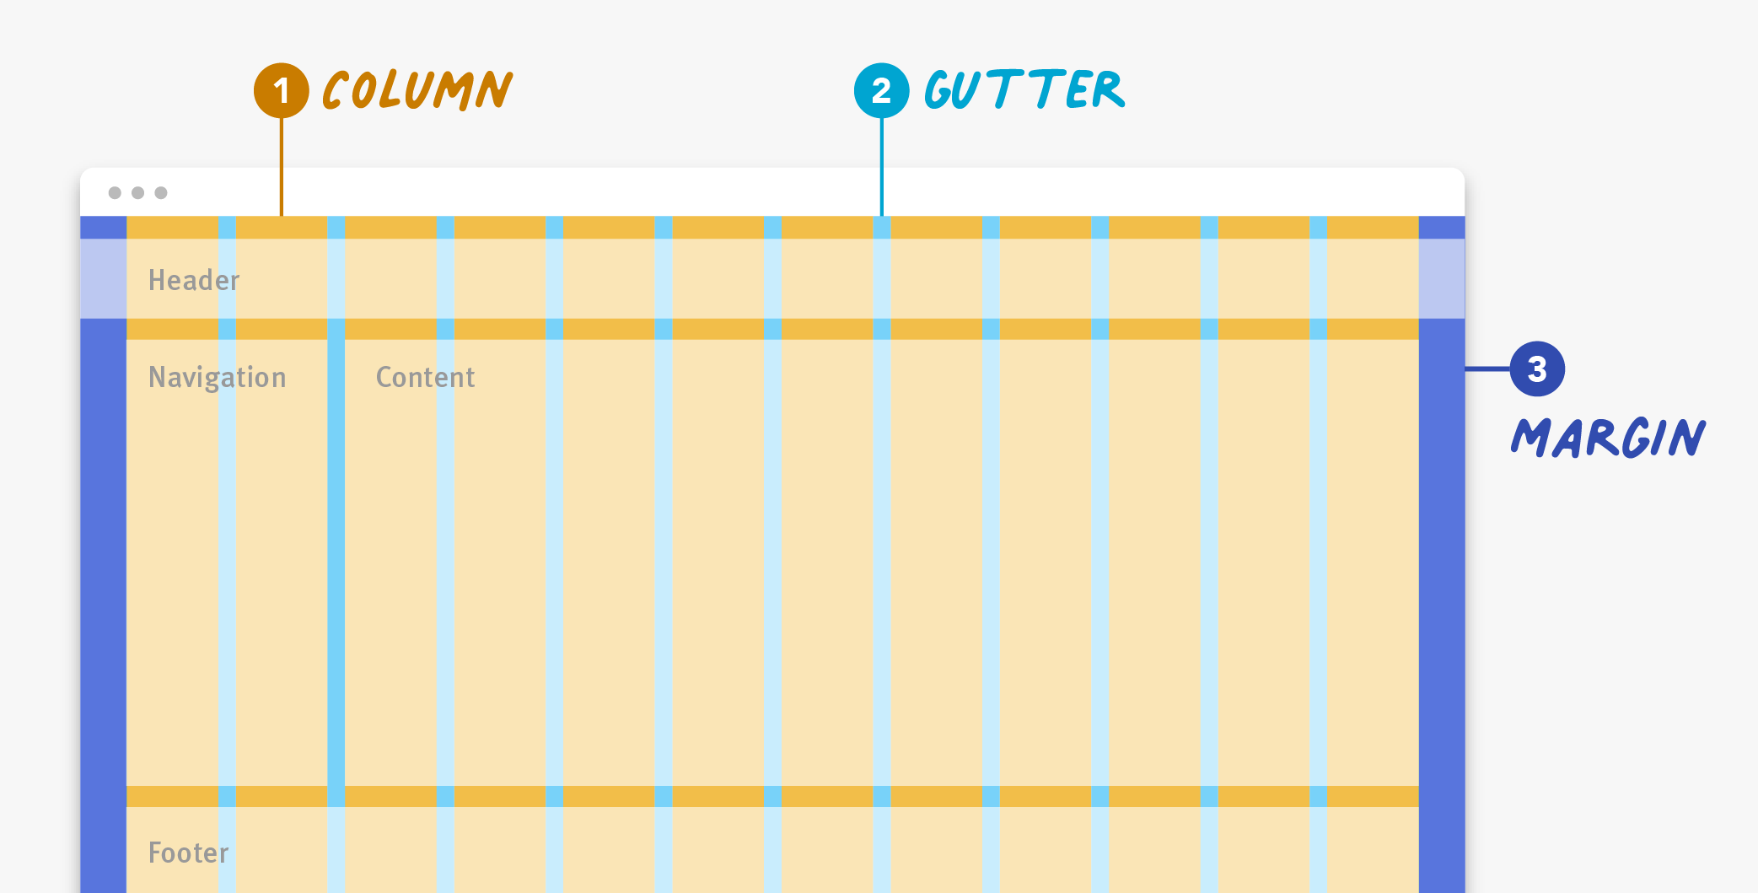
Grid Elements (contd.)

Slide 34
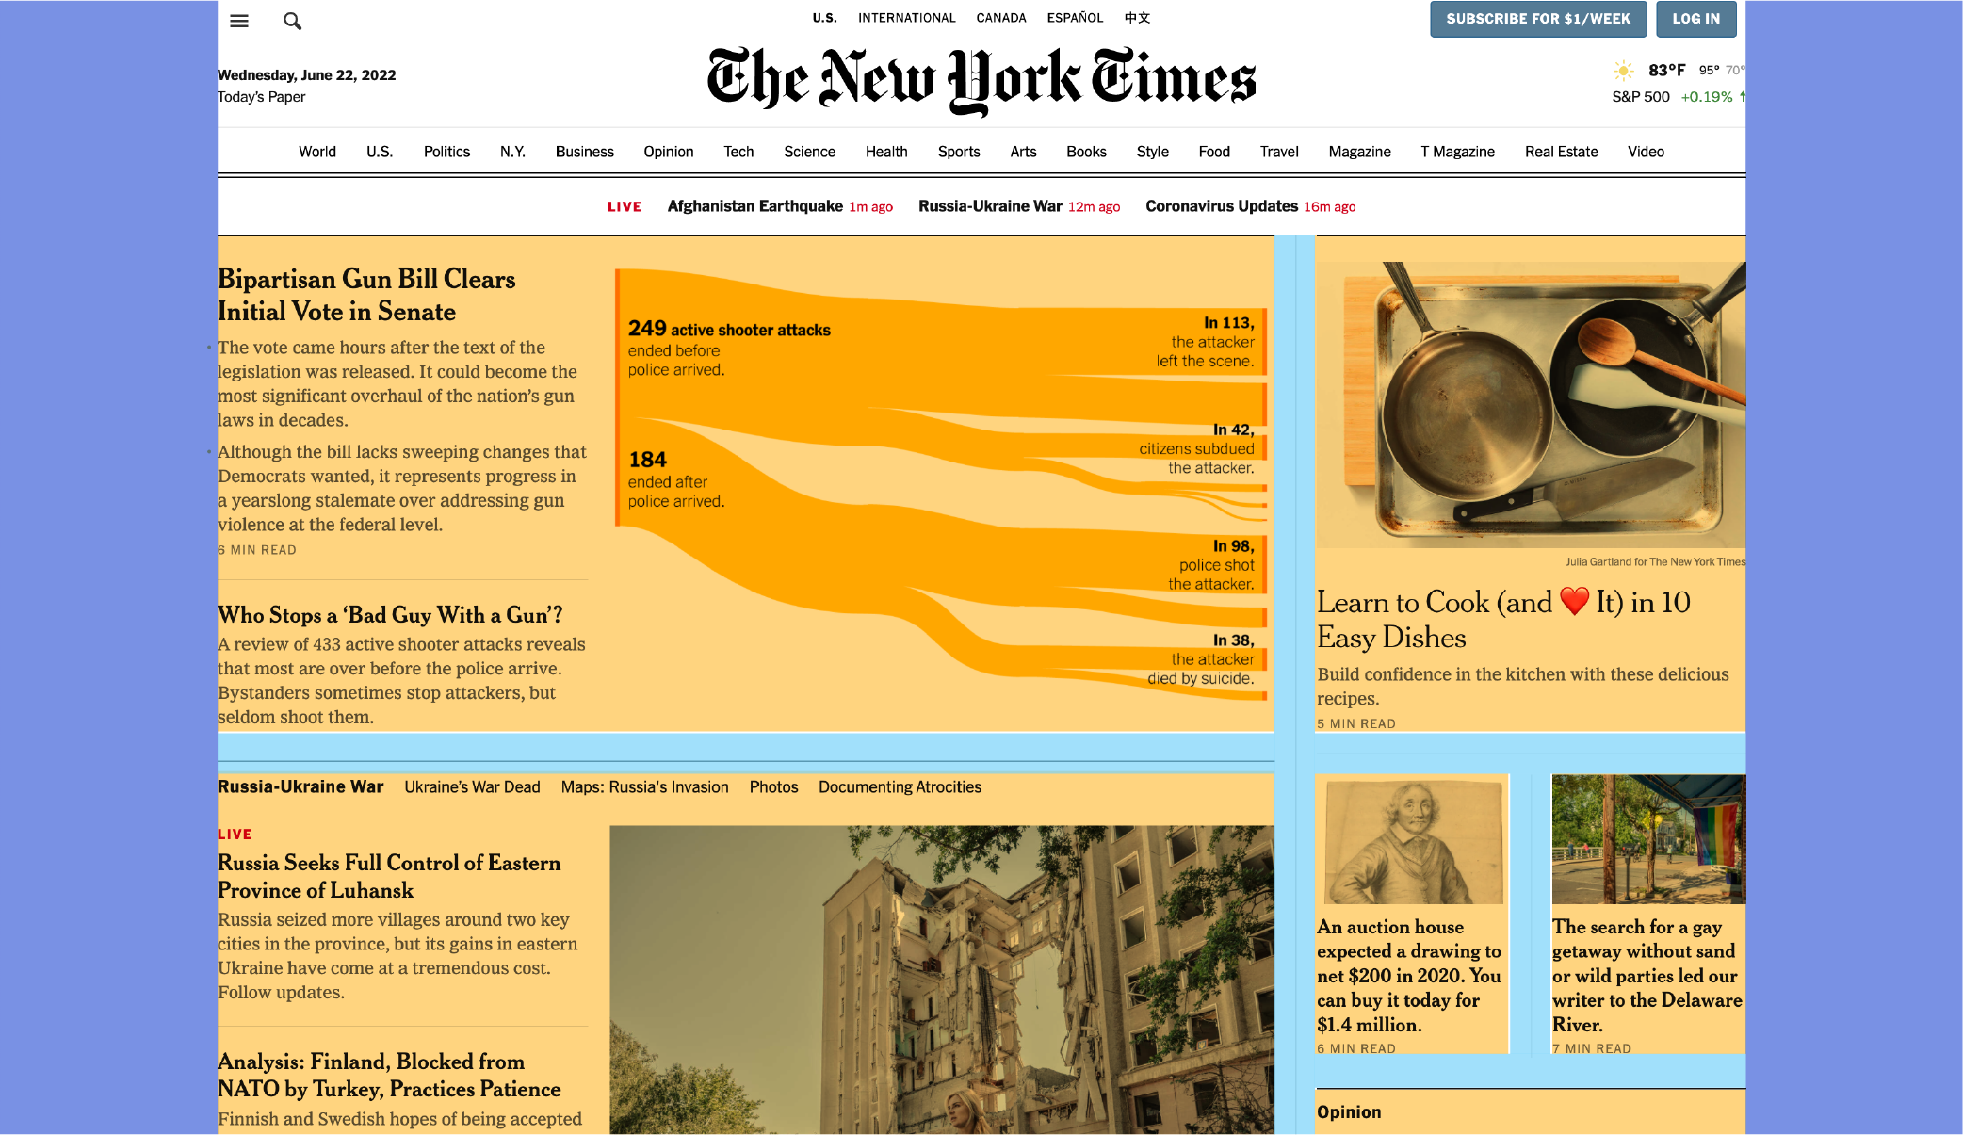
Grid System Example
Hierarchical Grid

Slide 35
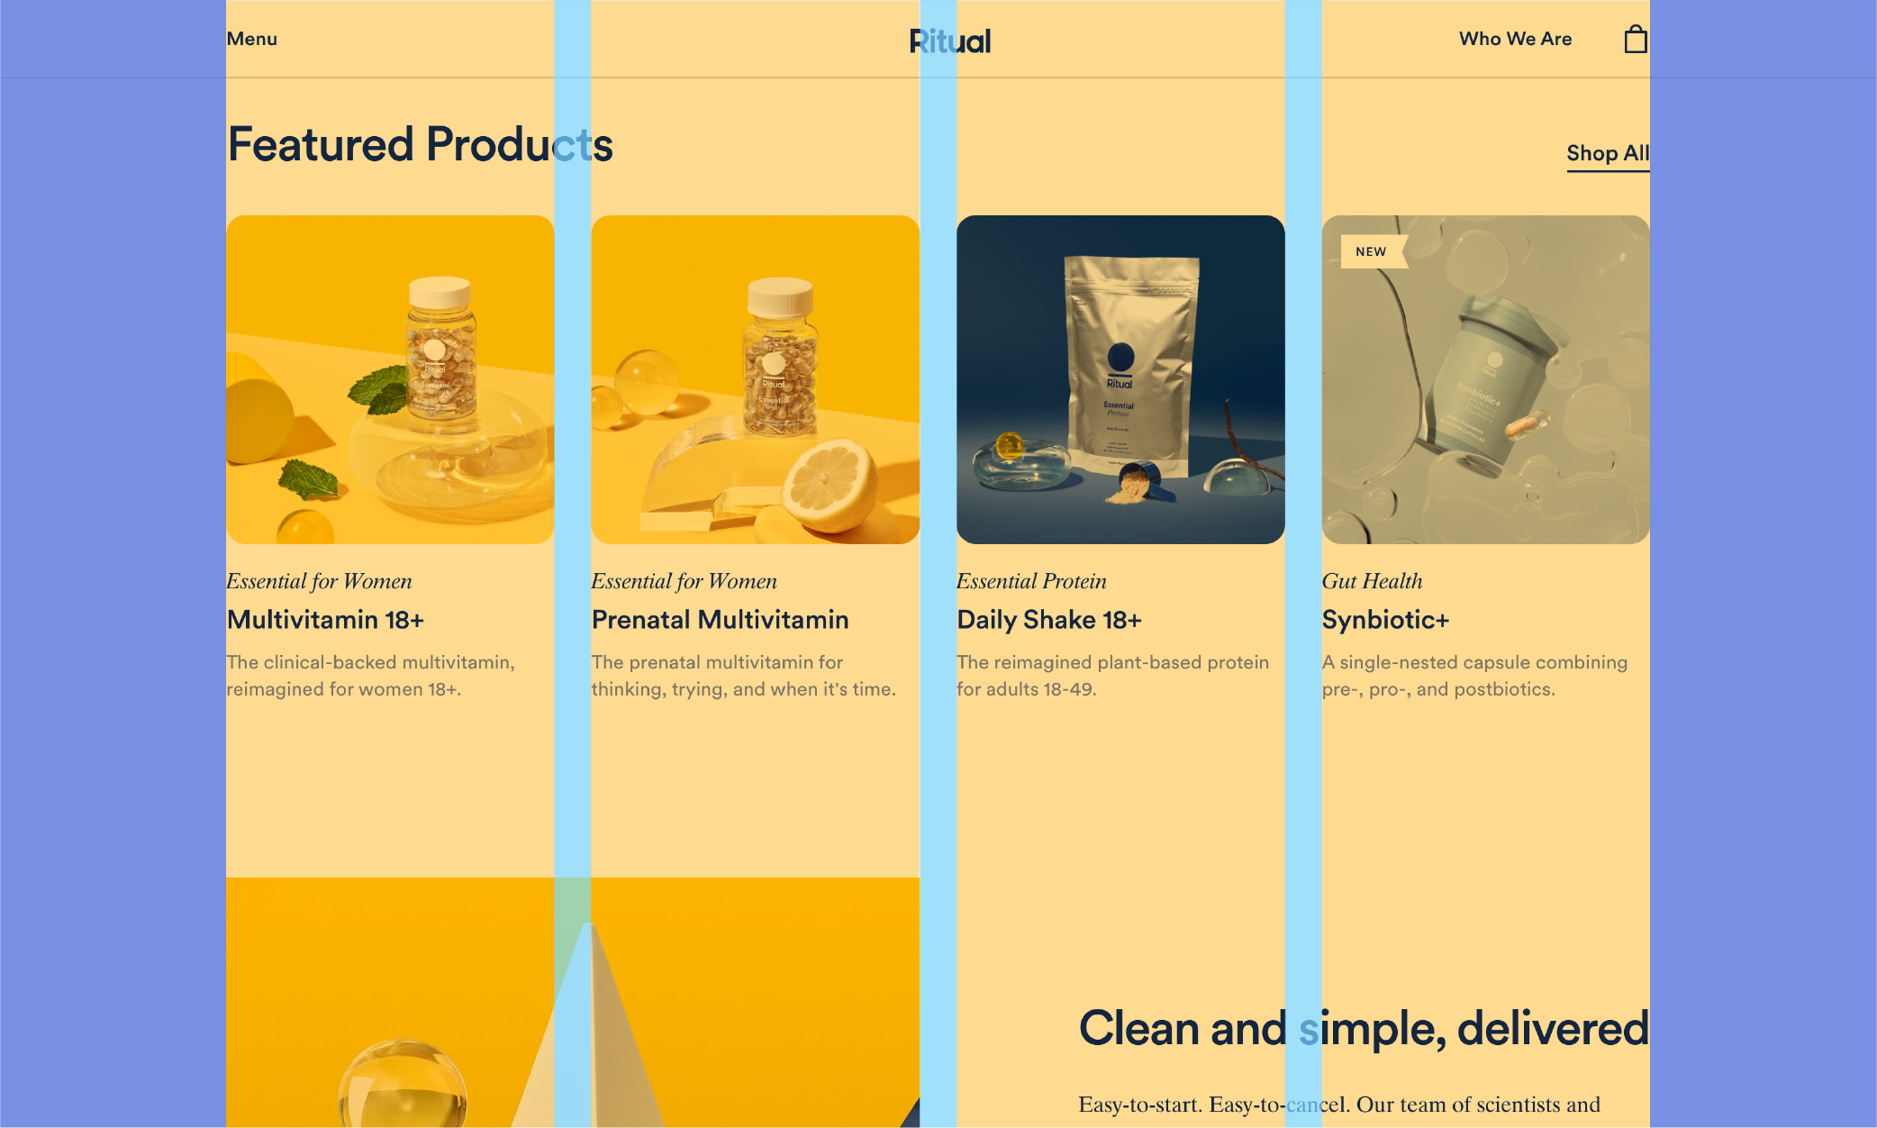
Grid System Example (contd.)
Column Grid

Slide 36
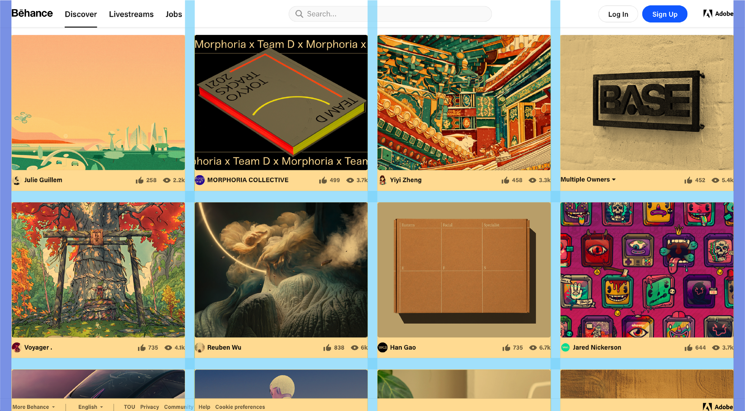
Grid System Example (contd.)
Modular Grid

Slide 37
Grid Benefits
Designers can quickly put together well-aligned interfaces.
Users can easily scan predictable grid-based interfaces.
A good grid is easy to adapt to various screen sizes and orientations.
Grid layouts are an essential component of responsive web design.
Responsive design uses breakpoints to determine the screen size threshold at which the layout should change.
E.g., a desktop screen may have 12 grid columns, which may be stacked on mobile so that the resulting layout has only 4 columns.

Slide 38
Interaction Design
Section – 5

Slide 39
Interaction Design
Interaction design (IxD) is a process of making human-to-computer interfaces (HCI) feel human-like.
Interactive digital products create this “human” connection by giving feedback to the end-users.
The feedback can be through a scroll-provoked animation, clicked state of a button or transition to another page.
Interaction design uses appropriate interactive elements, such as transitions, micro interactions, animation.
Interaction design is helpful in:
Greater product satisfaction
Deeper usability understanding
Faster learnability
A deeper personal connection
Increased likelihood of repeated use

Slide 40
Menu and Navigation
Section – 6

Slide 41

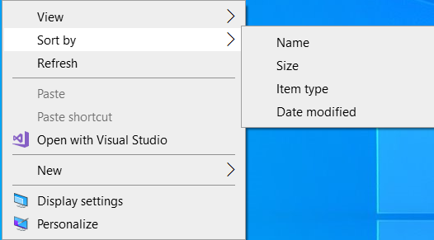


The Structures of Menus
Single Menus:
In this simplest form of menu, a single screen or window is presented to seek the user’s input or request an action to be performed.
Sequential Linear Menus:
Sequential linear menus are presented on a series of screens possessing only one path.
Simultaneous Menus:
Here, all menu options are available simultaneously.
The menu may be completed in the order desired by the user, choices being skipped and returned to later.
Hierarchical or Sequential Menus:
When many relationships exist between menu alternatives, and some menu options are only appropriate depending upon a previous menu selection, a hierarchical structure is the best solution.

Slide 42
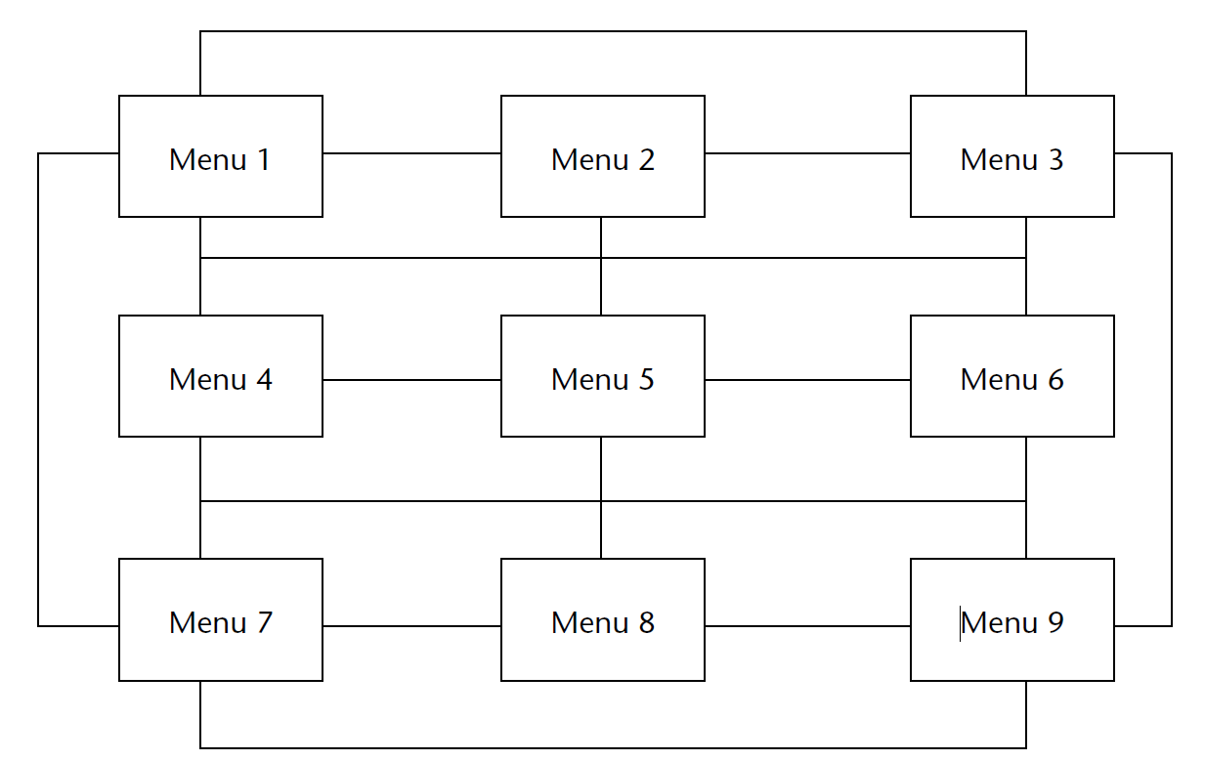
Cont…
Connected Menus:
Connected menus are networks of menus all interconnected in some manner.
Movement through a structure of menus is not restricted to a hierarchical tree, but is permitted between most or all menus in the network.
Event-Trapping Menus:
Event-trapping menus provide a background of control over the system’s state and parameters while the user is working on a foreground task.
E.g., a Paste option in a word will only function if there is something in a clipboard to paste.

Slide 43
Functions of Menus
Menus serve several functions depending on the context in which they're used. Here are some of their primary functions:
Navigation:
One of the fundamental roles of menus is to help users navigate through options or content.
In a restaurant, it guides customers through the available dishes, while in software or websites, menus facilitate movement between different sections or functions.
Information Organization:
Menus help organize information into categories, making it easier for users to find what they're looking for.
This could be categorizing food items in a restaurant menu or grouping features in software applications.
Access to Functions/Features:
In software and digital interfaces, menus provide access to various functions or features that might not be immediately visible.
They offer a convenient way to access a range of options without cluttering the main interface.
Consistency and Standardization:
Menus can establish a consistent structure across an application, website, or establishment,
making the user experience predictable and easier to navigate.

Slide 44
Cont…
User Control and Interaction:
Menus provide users with control over their experience by allowing them to select preferences, change settings, or execute specific commands.
This empowers users to interact with systems or applications according to their needs.
Contextual Guidance:
Contextual menus often provide relevant options based on the user's current actions or selections.
For instance, in software applications, right-clicking on an item brings up a menu with options specifically related to that item.
Efficiency and Time-Saving:
Well-designed menus streamline user interactions, saving time by offering direct access to commonly used functions or content.
They reduce the need for users to search extensively for what they need.
Communication and Marketing:
In a restaurant setting, menus not only list available items but also communicate the restaurant's brand, style, and sometimes even the story behind the dishes.
In a digital context, menus can be used to highlight new features or promotions.

Slide 45
Formatting of Menus
Consistency
Display
Presentation
Organization
Complexity
Item Arrangement
Line Separators
Ordering
Groupings
Selection Support Menus

Slide 46
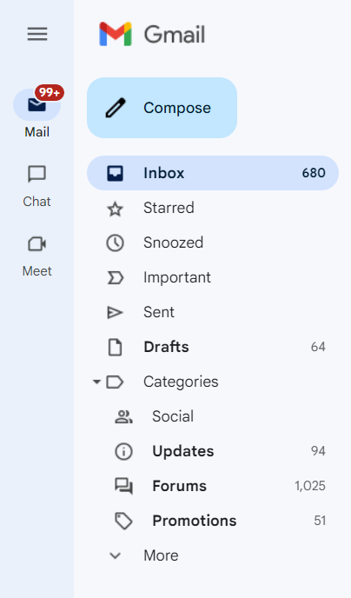
Consistency and Display
Consistency
Provide consistency with the user’s expectations.
Provide consistency in menu
Formatting, including organization, presentation, and choice ordering.
Phrasing, including titles, choice descriptions, and instructions.
Choice selection methods.
Navigation schemes.
Display
If frequent references to menu options are necessary, permanently display the menu in an area of the screen that will not obscure other screen data.
If only occasional references to menu options are necessary, the menu may be presented on demand. Critical options should be continuously displayed, however.

Slide 47

Presentation
Ensure that a menu and its choices are obvious to the user by presenting them with a unique and consistent structure, location, and/or display technique.
Ensure that other system components do not possess the same visual qualities as menu choices.

Slide 48
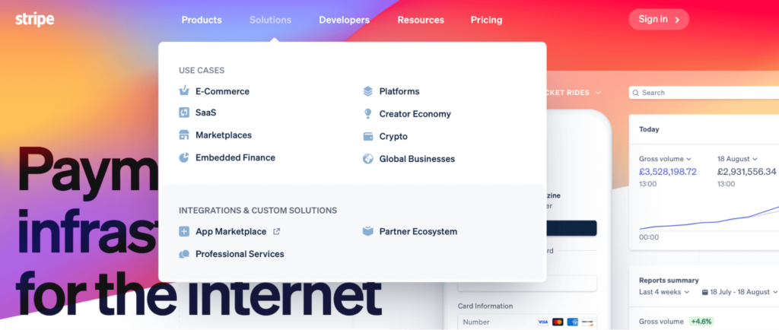
Organization
Provide a general or main menu.
Display all relevant alternatives and ensure only relevant alternatives will display other should be deleted or gray-out.
Match the menu structure to the structure of the task.
Minimize number of menu levels within limits of clarity.
For Web sites, restrict it to two levels (requiring two mouse clicks) for fastest performance.
Be conservative in the number of menu choices presented on a screen.
Without logical groupings of elements, limit choices to 4 to 8.
With logical groupings of elements, limit choices to 18 to 24.
Provide decreasing direction menus, if sensible.
Never make menus to be scrolled.

Slide 49
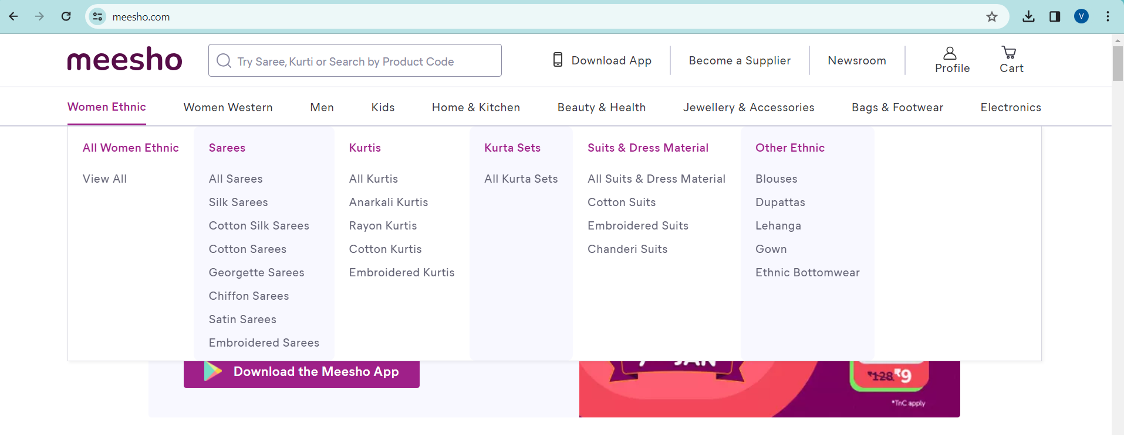
Complexity
Provide both simple and complex menus.
Simple: a minimal set of actions and menus.
Complex: a complete set of actions and menus.

Slide 50
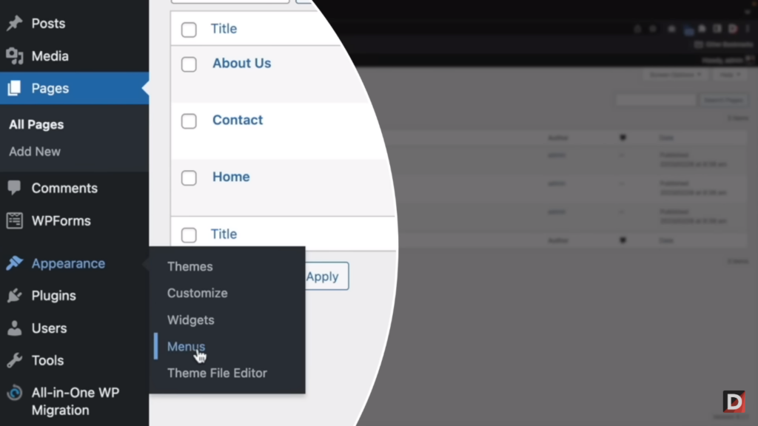
Item Arrangement
Align alternatives or choices into single columns whenever possible.
Orient for top-to-bottom reading.
Left-justify descriptions.
If a horizontal orientation of descriptions must be maintained
Organize for left-to-right reading.

Slide 51
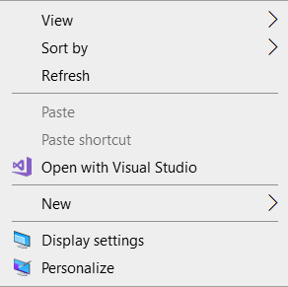
Line Separators
Separate vertically arrayed groupings with solid lines.
Separate vertically arrayed subgroupings with subtle dotted or dashed lines.

Slide 52
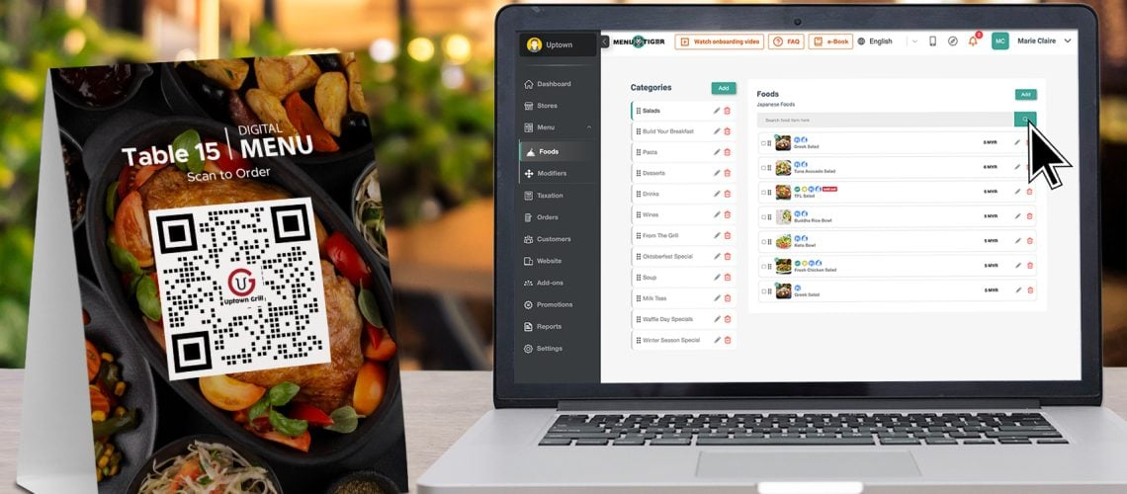
Ordering
Order lists of choices by their natural order, or
For lists associated with numbers, use numeric order.
For textual lists with a small number of options (seven or less), order by
Sequence of occurrence.
Frequency of occurrence.
Importance.
Semantic similarity.
Use alphabetic order for
Long lists (eight or more options).
Short lists with no obvious pattern or frequency.
Separate potentially destructive actions from frequently chosen items.
Maintain a consistent ordering of options on all related menus.
For variable-length menus, maintain consistent relative positions.
For fixed-length menus, maintain consistent absolute positions.

Slide 53
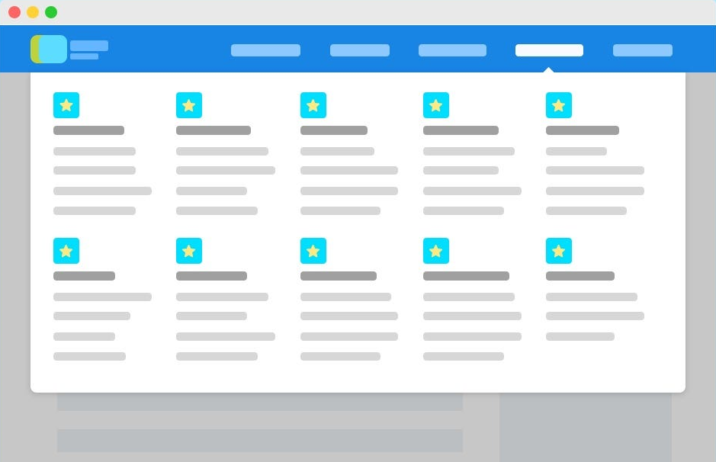
Grouping
Create groupings of items that are logical, distinctive, & mutually exclusive.
Categorize them in such a way as to
Maximize the similarity of items within a category.
Minimize the similarity of items across categories.
Present no more than six or seven groupings on a screen.
Order categorized groupings in a meaningful way.
If meaningful categories cannot be developed and more than eight options must be displayed on a screen, create arbitrary visual groupings that
Consist of about four or five, but never more than seven options.
Are of equal size.
Separate groupings created through either
Wider spacing, or
A thin ruled line.
Provide immediate access to critical or frequently chosen items.

Slide 54
Web Site Navigation
Navigation refers to the method people use to find what they want in a Web site.
To navigate to a destination, people use available space-based and environmental information, a process called wayfinding.
Wayfinding involves four stages:
Orientation
One’s current location relative to nearby objects and the destination must be determined, this is called orientation.
Route decision
A path must be chosen to get to the destination.
Route decision making is improved by minimizing the number of navigational choices, and by providing signs or prompts at decision points.

Slide 55
Web Site Navigation
Route monitoring
The chosen route must be monitored to confirm that it is leading to the proper destination.
Destination recognition
The destination, when it is found, must be easily recognized.
To aid recognition, provide clear and consistent identities to destinations.

Slide 56
Web Site Navigation Problems
Technical Navigation Issues:
Non-Linear Navigation: Unlike traditional graphical systems, the web's nature allows users to jump between pages in no prescribed sequence, which might lead to disorientation.
Multiple Navigational Systems: Users deal with both the browser's navigation (Back button, for instance) and the website's internal links, which might not always align seamlessly.
Growing Complexity: Websites tend to expand over time, potentially leading to complex structures and menus that make finding information challenging.
Usage Problems:
Heavy Mental Load: Users may feel overwhelmed by the number of links presented on a page or struggle to distinguish the relevance of each link to their task.
Spatial Disorientation: Users might feel lost in the web space due to inadequate understanding of the site's layout or structure. Scrolling pages or long chains of links can lead to loss of context and disorientation.
Abandonment due to Difficulty: If navigation becomes too challenging or information overload occurs, users may abandon their tasks, impacting goals like completing purchases on shopping sites.

Slide 57
Web Site Navigation Problems Solutions
Clear Link Labels: Websites should provide clear and descriptive link labels, offering users a better idea of where they'll be directed.
Consistent Structure: Maintaining a consistent layout and navigation structure can aid users in developing mental models of the website.
Reduced Cognitive Load: Minimize unnecessary links or information overload, providing users with a smoother and less overwhelming experience.

Slide 58
Web Site Navigation Goals
Crucial aspect of website navigation:
The inherent complexity due to the lack of perceived structure compared to traditional applications.
The web's open-ended nature, with pages of varying lengths and an abundance of interconnected links, can easily disorient users.
Its effectiveness lies in facilitating quick and easy movement between components with a clear and easily understandable structure and relationship.
The key questions you've outlined are fundamental for users to navigate seamlessly:
Where am I now?: Providing users with clear indications of their current location within the website is essential for context.
Where did I come from?: Understanding the path taken to arrive at the current page aids in retracing steps if needed.

Slide 59
Cont…
Where can I go from here?: Clearly presenting available options for further navigation allows users to make informed choices.
How can I get there quickly?: Offering efficient pathways or tools for swift navigation within the website improves user experience.
A robust navigational scheme with intuitive features and tools can significantly lessen the problems associated with cognitive overload and feelings of disorientation.

Slide 60
Web Site Navigation Aids
To aid Web site navigation and learning
Provide a map or overview of the menu hierarchy.
Provide click ability prompts.
Provide a “look ahead” at the next level of choices, alternatives that will be presented when a currently viewed choice is selected.
Change the color of a link that has been clicked.
Provide feedback concerning one’s current location
Provide navigation history.
Provide breadcrumbs.
Match link text to the destination page heading.

Slide 61
Web Site Organization
Divide content into logical fragments, or units.
Establish a hierarchy of generality or importance.
Restrict to two levels requiring no more than two clicks to reach deepest content, whenever possible.

Slide 62
Navigation Elements
Differentiate and group navigation elements.
Provide a global navigation bar at the top of each page.
Provide a local category or topical links navigation bar on the left side of a page.
For long lists, consider placing within a frame.
Optionally, provide a secondary navigation column on the right side of the page.
Provide explicit or embedded textual links within the contents area.
Consider duplicating embedded links in the left side navigation bar.
Place minor illustrative, parenthetical, or footnote links at the end of the page.
For long pages provide
“List of Content” Links.
Important global or local links in a navigation bar repeated at the page bottom.
Create a common and consistent theme.

Slide 63
Other Web Site Navigation Elements
Overviews
Provide
An executive summary that provides a preview of the site and contains links to all major concepts.
A site map illustrating the site’s hierarchical structure and the relationships of components.
Both global and local maps.
An alphabetized site index.
A table of contents.
Allow accessibility from any point in the Web site.
Historical Trails
Provide
Breadcrumb trails. Locate at the top of the page below the navigation links.
History lists.
History trees.
Footprints.
Bookmarks.
Search Facility

Slide 64
Cont…
Links and Actions
Textual Phrase Links. Embedded within page text.
Image Links.
Command Buttons and Toolbars
Appear in an array in the form of a navigation bar, or be individually located at relevant points in a page.

Slide 65
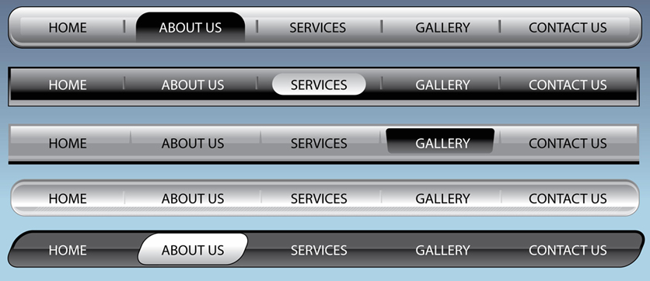
Kinds of Graphical Menus - Menu Bar
Proper usage:
To identify and provide access to common and frequently used application actions that take place in a wide variety of different windows.
A menu bar choice by itself should not initiate an action.
Advantages | Disadvantages
Are always visible, reminding the user of their existence. Are easy to browse through. Are easy to locate consistently on the screen. Usually do not obscure the screen working area. Usually are not obscured by windows and dialog boxes. Allow for use of keyboard equivalents. | They consume a full row of screen space. They require moving pointer from the main working area to select. The menu options are smaller than full-size buttons, slowing selection time.

Slide 66
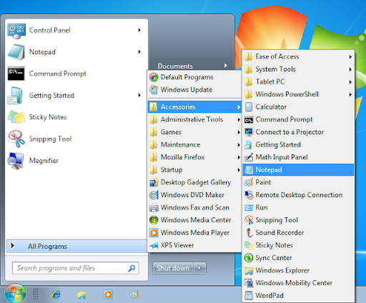
Kinds of Graphical Menus - Cascading Menus
Usage:
To reduce the number of choices presented together for selection (reduce menu breadth).
When a menu specifies many alternatives and the alternatives can be grouped in meaningful related sets on a lower-level menu.
When there are several fixed sets of related options.
To simplify a menu.
Avoid using for frequent, repetitive commands.

Slide 67
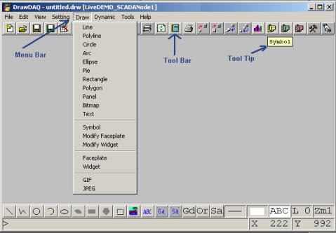
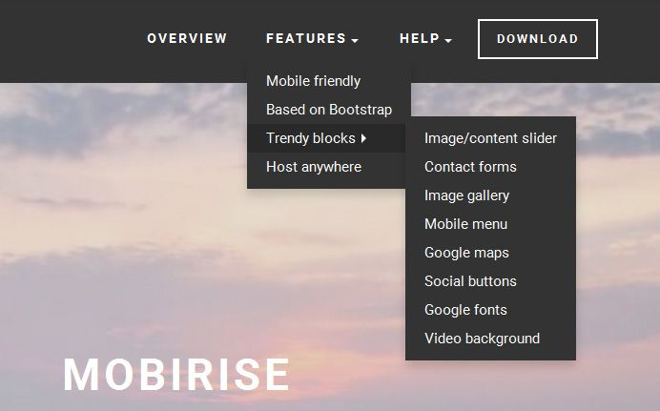
Kinds of Graphical Menus - Pull-Down Menu
Usage:
To initiate frequently used application actions that take place on a wide variety of different windows.
Items best represented textually.
Items whose content rarely changes.
Advantages | Disadvantages
The menu bar cues a reminder of their existence. They may be located relatively consistently on the screen. No window space is consumed when they are not used. They are easy to browse through. Their vertical orientation is most efficient for scanning. Their vertical orientation is most efficient for grouping. Their vertical orientation permits more choices to be displayed. They allow for display of both keyboard equivalents and accelerators. | They require searching and selecting from another menu before seeing options. They require looking away from main working area to read. They require moving the pointer out of working area to select (unless using keyboard equivalents). The items are smaller than full-size buttons, slowing selection time. They may obscure the screen working area.

Slide 68
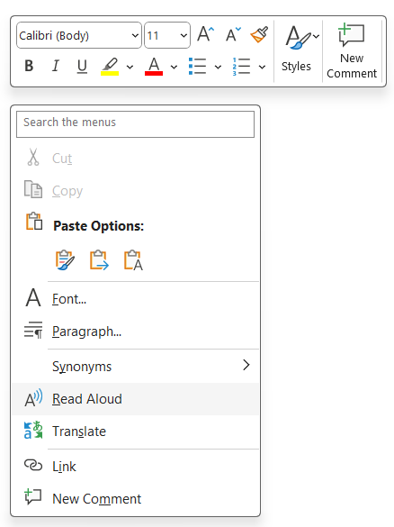
Kinds of Graphical Menus - Pop-Up Menus
Use to present alternatives or choices within the context of the task.
Advantages | Disadvantages
They appear in the working area. They do not use window space when not displayed. No pointer movement is needed if selected by button. Their vertical orientation is most efficient scanning. Their vertical orientation most efficient for grouping. Their vertical orientation allows more choices to be displayed. They may be able to remain showing (“pinned”) when used frequently. They allow for display of both keyboard equivalents and accelerators. | Their existence must be learned and remembered. Means for selecting them must be learned and remembered. They require a special action to see the menu (mouse click). Items are smaller than full-size buttons, slowing selection time. They may obscure the screen working area. Their display locations may not be consistent.

Slide 69
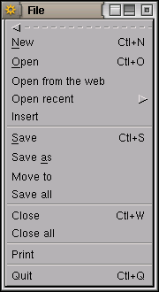
Kinds of Graphical Menus - Tear-Off Menus
A tear-off menu is a pull-down menu that can be positioned anywhere on the screen for constant referral.

Slide 70
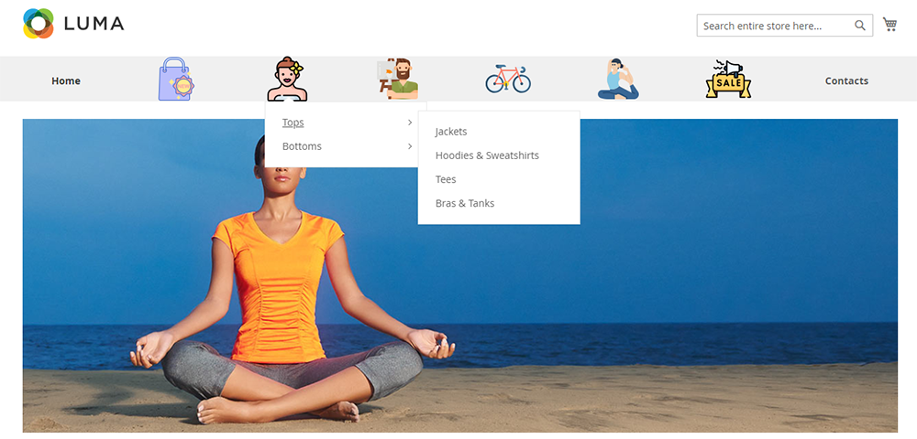
Kinds of Graphical Menus - Iconic Menus
Use to remind users of the functions, commands, attributes, or application choices available.
Create icons that
Help enhance recognition and hasten option selection.
Are concrete and meaningful.
Clearly represent choices.
Advantages | Disadvantages
Pictures help facilitate memory of applications. Larger size increases speed of selection. | Consume considerably more screen space than text. Difficult to organize for scanning efficiency. To create meaningful icons requires special skills. To create meaningful icons requires extended amount of time.

Slide 71
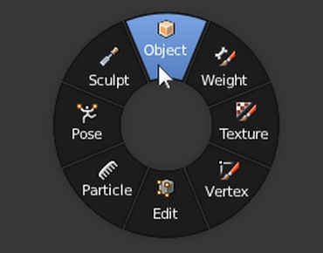
Kinds of Graphical Menus - Pie Menus
A pie menu is a circular representation of menu items.
Consider using for
Mouse-driven selections, with one- or two-level hierarchies, short lists, and choices helpful to the format.

Slide 72
Error Message Guidelines
Section – 7

Slide 73
Error Message Guidelines
Error message is a system-generated interruption to the user's workflow that informs the user of an incomplete, incompatible, or undesirable situation according to the system's implementation.
Follow bellow guidelines for error messages:
Visibility Guidelines
Communication Guidelines
Efficiency Guidelines
Mitigate Failure with Novelty in Dire Situations

Slide 74
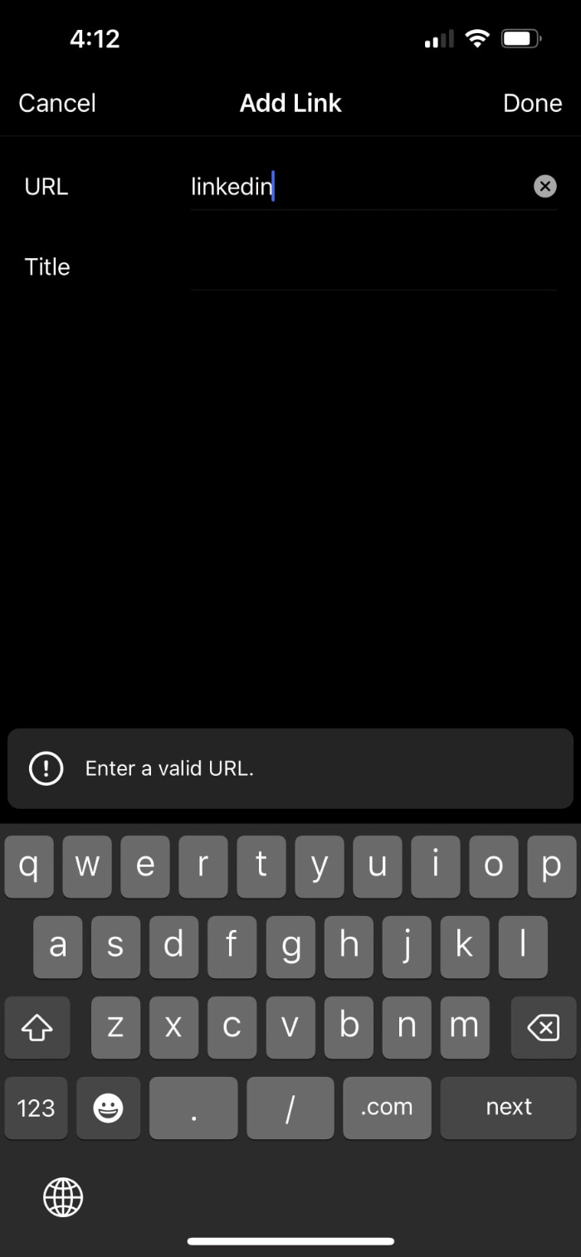
Visibility Guidelines
Error messages must present themselves noticeably and recognizably to users.
Display the error message close to the error's source.
Reduce cognitive load by displaying an error indicator adjacent to the interface where the error occurred.
Proximity helps users associate the error message content with the interface elements needing attention.

Slide 75
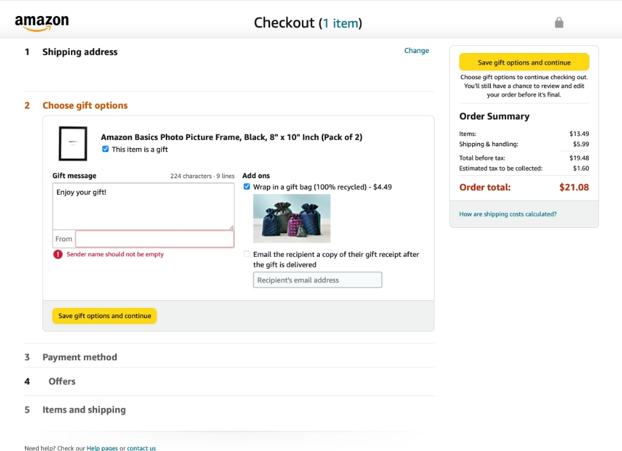
Use noticeable, redundant, and accessible indicators
Text and highlights that are bold, high-contrast, and red are conventional error-message visuals.
Use this styling for the message and for the affected elements needing correction.
Leverage carefully designed animations to guide the user's visual attention for corrections.
Remember accessibility guidelines to aid the roughly 350 million people worldwide with a color-vision deficiency, and never use exclusively color or animation to indicate errors.

Slide 76
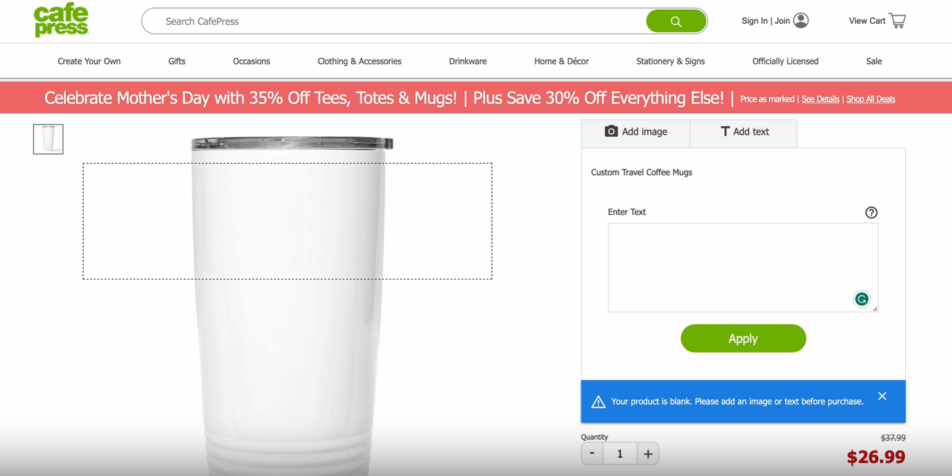
Use noticeable, redundant, and accessible indicators (contd.)

Slide 77
Design errors based on their impact
Design your error messages to indicate the problem's severity.
E.g., sometimes users only need to be warned of unexpected or potentially undesirable outcomes but can otherwise advance their workflow.
Differentiate between these "good to know" messages from those posing a barrier to the user's progress.
E.g., conditionally displayed labels, toast notifications, or banners can be used for issues needing minimal user interaction, whereas modal dialogs require the user's attention and resolution and should be reserved for severe errors.

Slide 78
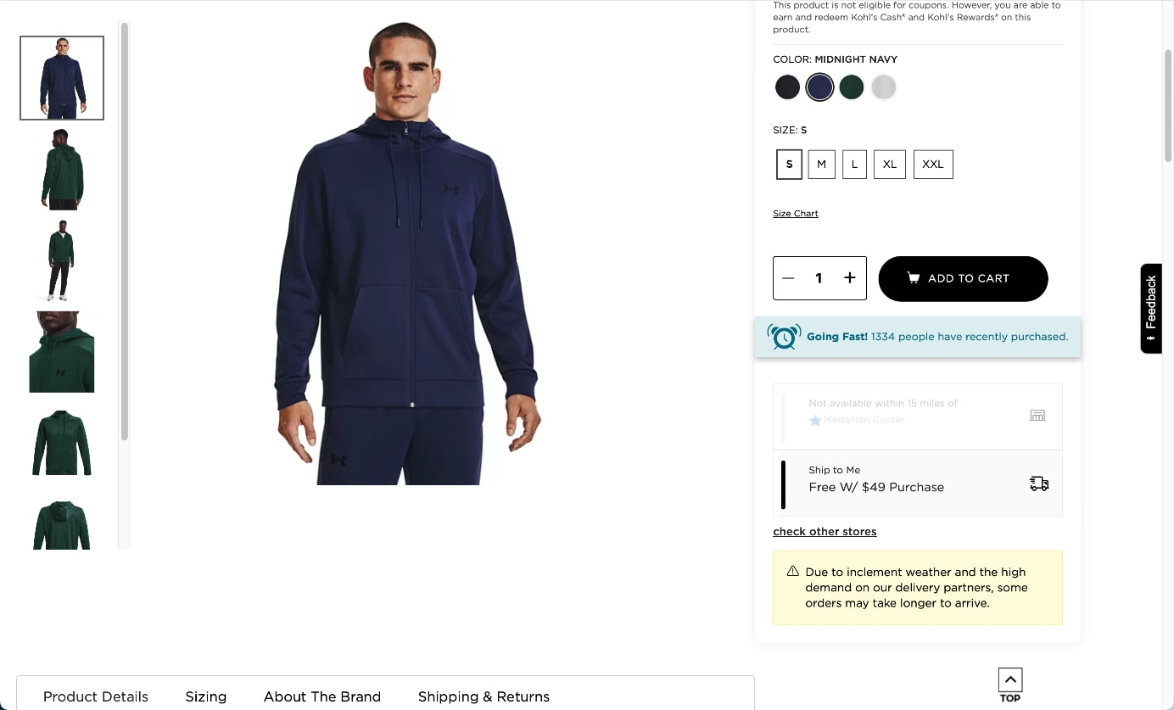
Design errors based on their impact

Slide 79
Avoid prematurely displaying errors
Timing is a crucial aspect of designing effective error messages.
Presenting errors too early is an unfriendly pattern.
It’s like grading a test before the student has had a chance to answer.
It can make users feel annoyed, belittled, or confused.
Don't assume that exploratory interactions (like the user moving text focus from a text box without filling it in) are errors.
Do consider inline, real-time errors for error-prone interactions where users are unlikely to enter the correct information on their first try.
This immediate guidance reduces interaction costs for correction.

Slide 80
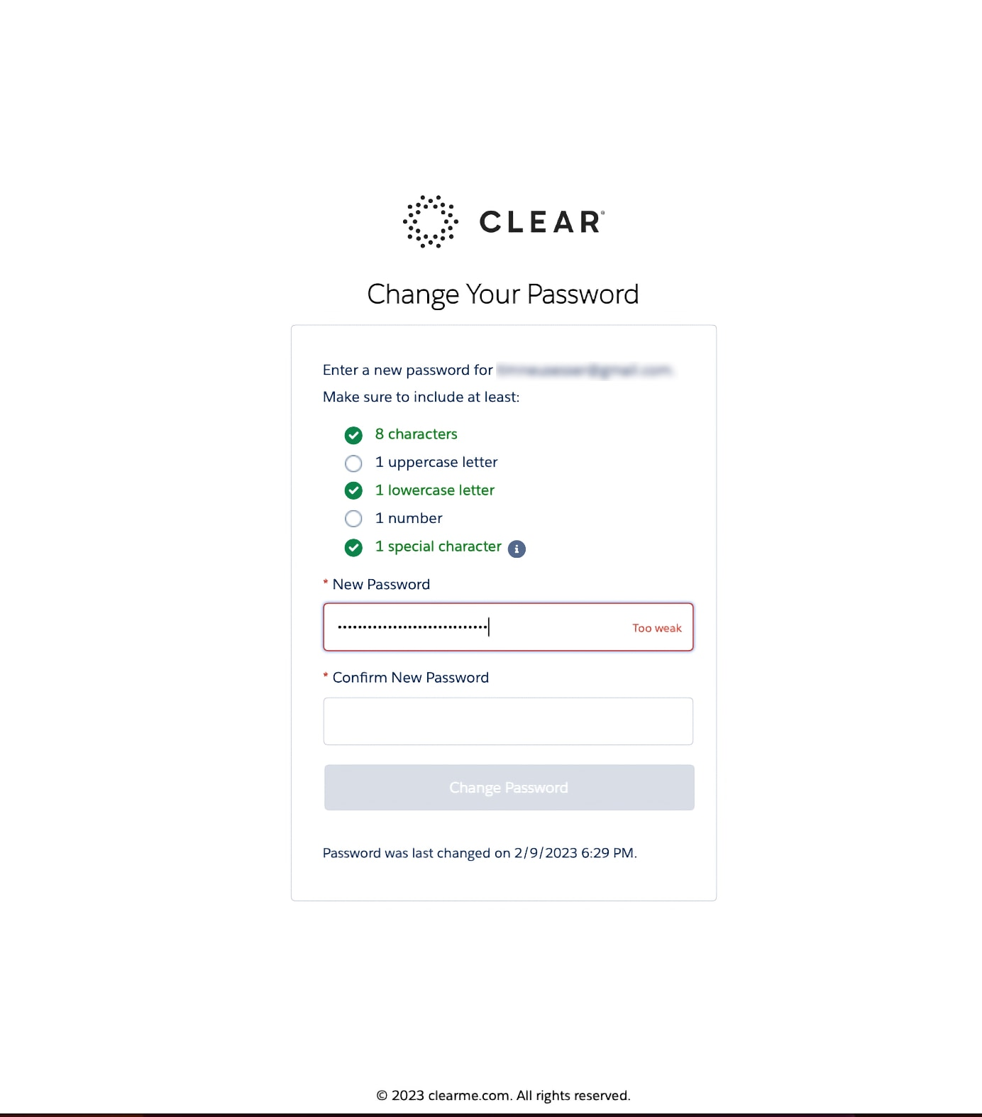
Avoid prematurely displaying errors

Slide 81
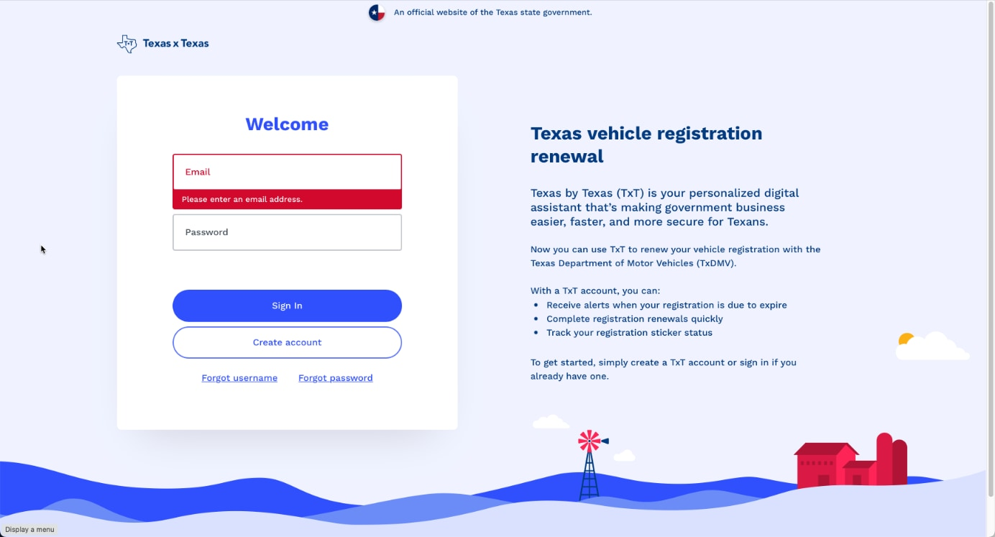
Avoid prematurely displaying errors

Slide 82
Communication Guidelines
Use human-readable language.
Error messages should be plainspoken using legible and readable text.
Avoid technical jargon and use language familiar to your users instead.
The Web's most common error message, the 404 page, violates this guideline.
Hide or minimize the use of obscure error codes or abbreviations; show them for technical diagnostic purposes only.
Concisely and precisely describe the issue.
Generic messages such as An error occurred lack context.
Provide descriptions of the exact problems to help users understand what happened.
That said, beware of excessive technical precision and accuracy that can undermine understandability.
The user's mental model of how the system works likely differs from the conceptual model of how it was coded.

Slide 83
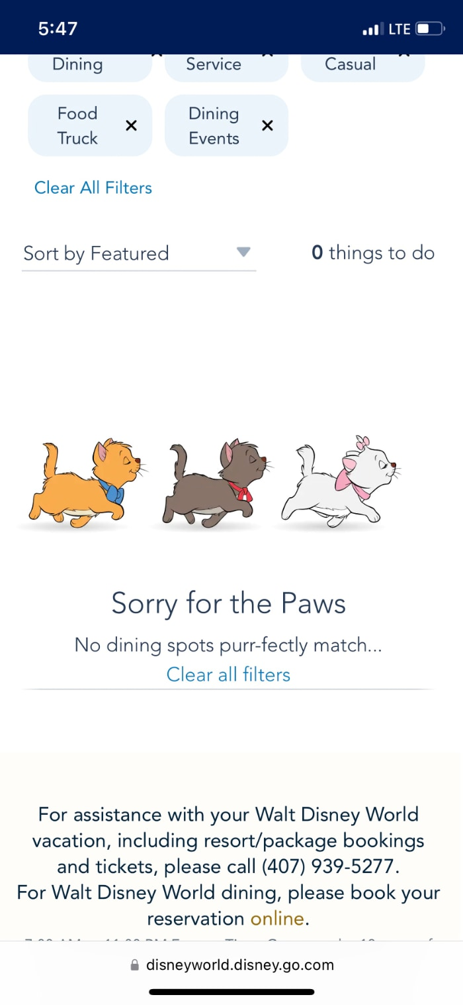
Communication Guidelines

Slide 84
Communication Guidelines
Offer constructive advice.
Merely stating the problem is also not enough; offer some potential remedies.
E.g., Out of stock message for an ecommerce website. Include details of when the product will be available again or suggest that users sign up for a restock notification by entering their emails.
Take a positive tone and don't blame the user.
Write with a positive and nonjudgmental tone of voice.
Don't use phrasing that blames users or implies they are doing something wrong, such as invalid, illegal, or incorrect.
Avoid humor since it can become hard if users encounter the error frequently.

Slide 85
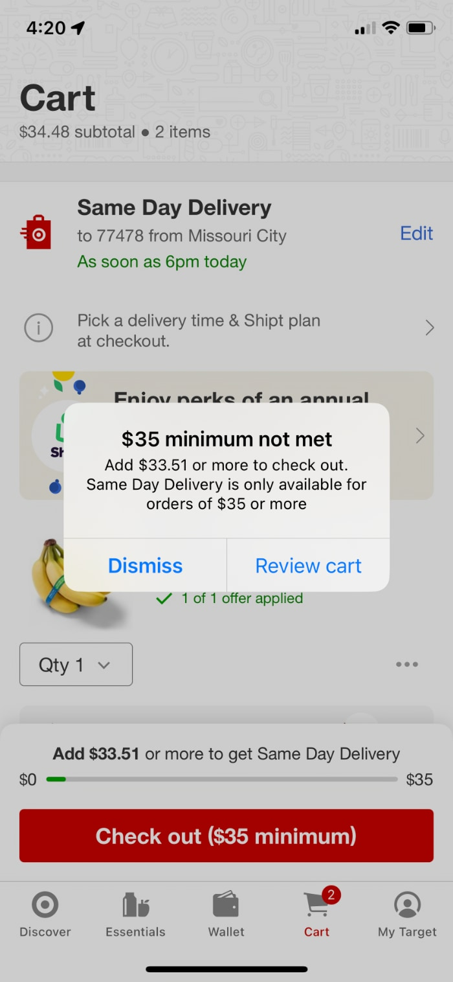
Communication Guidelines

Slide 86
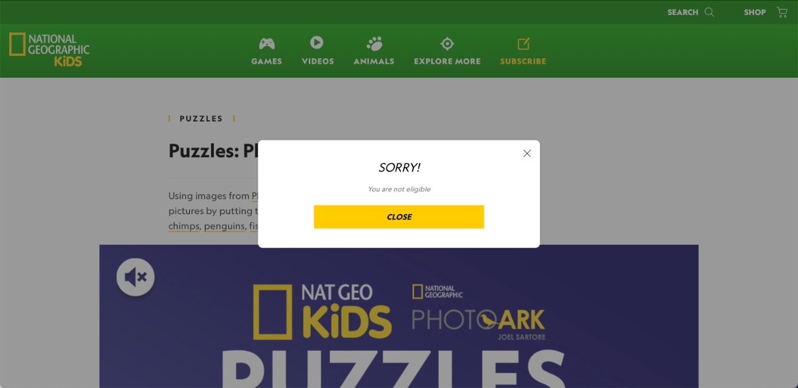
Communication Guidelines

Slide 87
Efficiency Guidelines
Good errors go beyond just explaining but protect the user's effort and time.
Offer accelerators to resolve the situation or share a bit of instruction to aid users' understanding and hopefully avoid the problem in the future.
Safeguard against likely mistakes.
The very worst error messages are those that don't exist.
When users make a mistake and receive no feedback, it can create a cascade of misunderstanding, wasted effort, and frustration.
E.g., email apps would dutifully send your email even though it referred to an attachment you forgot to include. Most apps will detect this situation and prompt you with an error message before sending it, thus sparing you embarrassment.

Slide 88
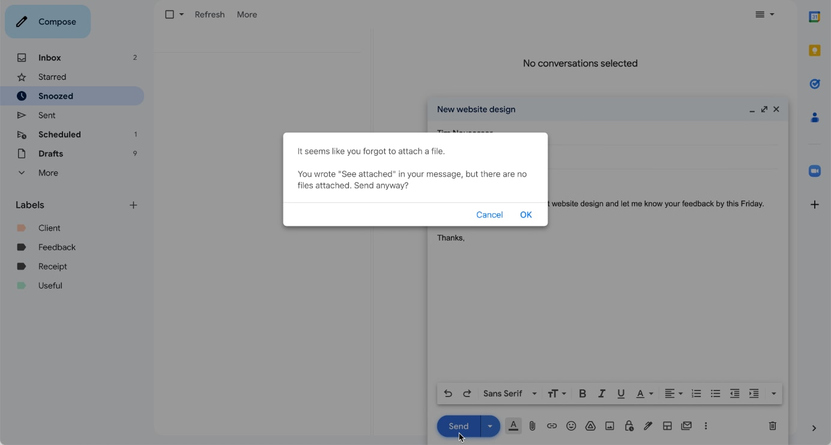
Efficiency Guidelines

Slide 89
Efficiency Guidelines
Preserve the user's input.
Let users correct errors by editing their original action instead of starting over.
E.g., display the original text entered into a text field even if it does not match the requirements for that field and allow the user to modify it.
Reduce error-correction effort.
If possible, guess the correct action and let users pick it from a small list of fixes.
E.g., instead of just saying City and ZIP code don't match, let users click on a button for the city that matches the ZIP code they entered.
Concisely educate on how the system works.
Use hypertext links to connect a concise error message to a page with supplementary material or an explanation of the problem.

Slide 90
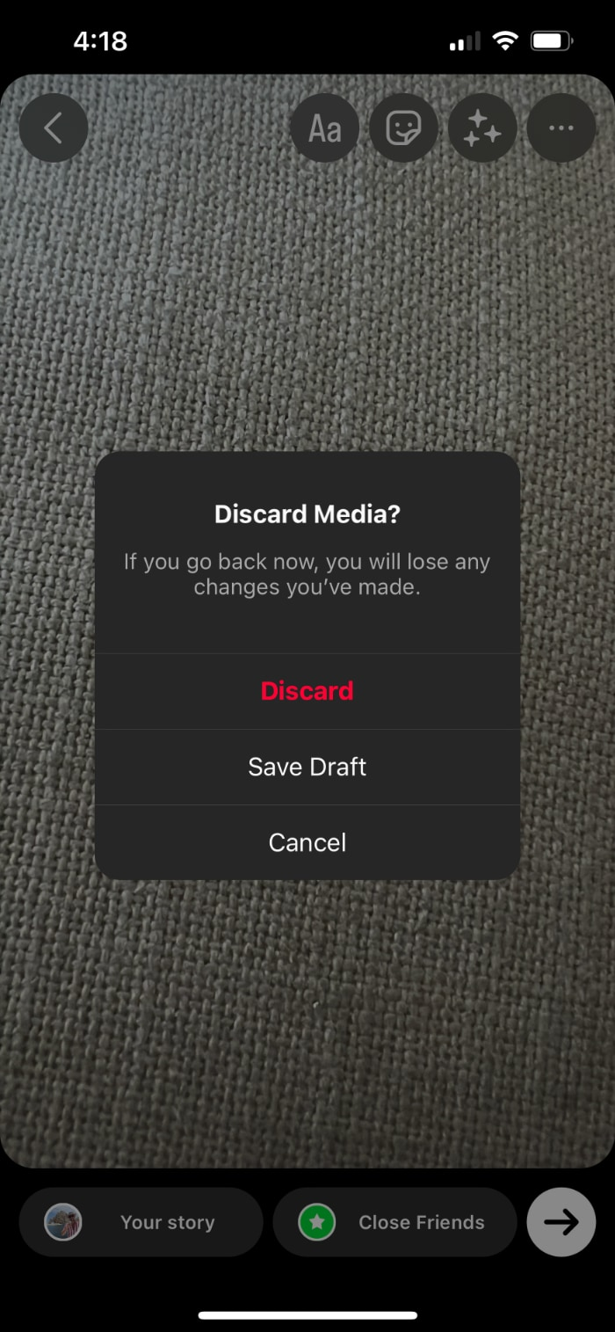
Efficiency Guidelines (contd.)

Slide 91
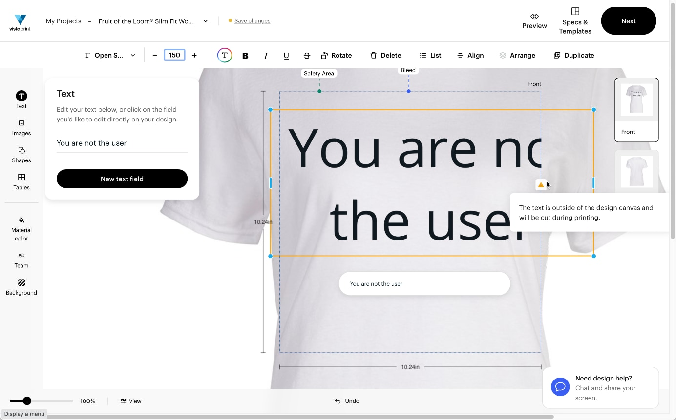
Efficiency Guidelines (contd.)

Slide 92
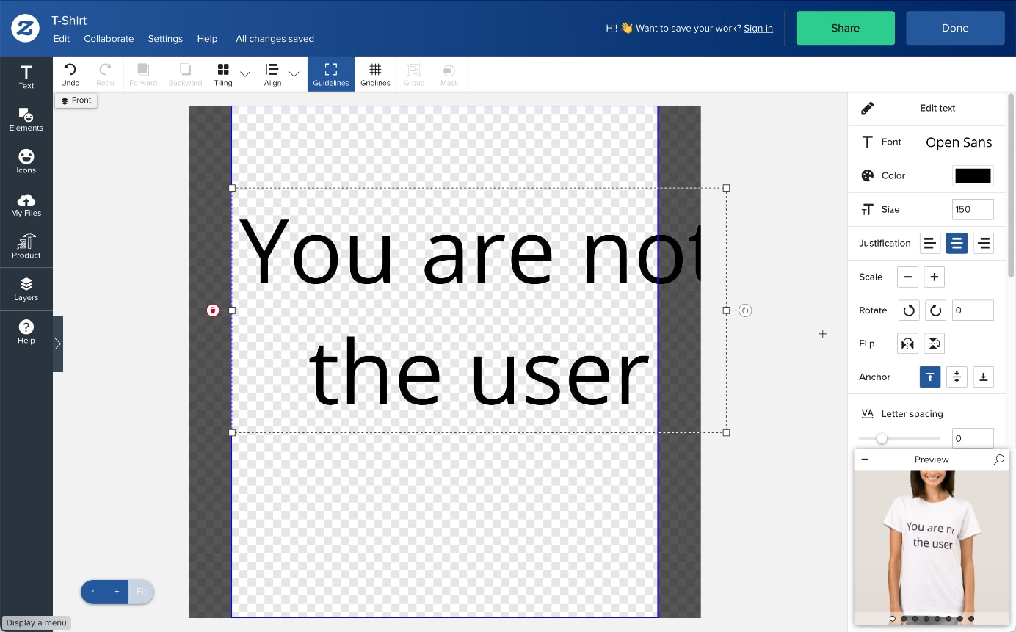
Efficiency Guidelines (contd.)

Slide 93
Ease Failure with Originality in Awful Situations
Errors are unenjoyable for everyone involved as they interfere with user and business goals.
Yet sometimes users may encounter an error so catastrophic (e.g., overloaded servers) there is no recourse but to wait or try again later.
Blend an apology with something surprising or novel may save a disappointing situation that users will likely remember.

Slide 94
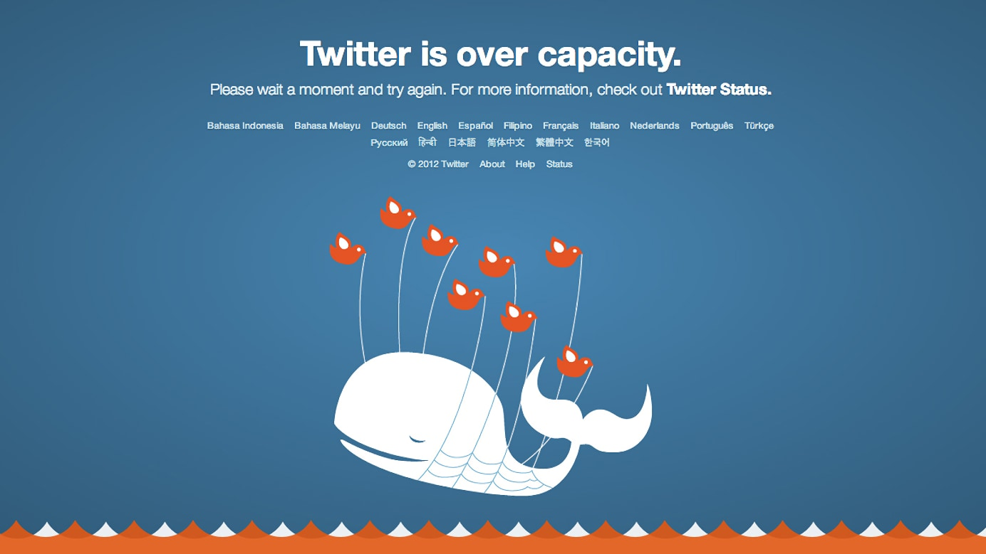
Ease Failure with Originality in Awful Situations

Slide 95
Thank you

